Slide 1

Agentic AI with TrueFoundry
(1 week self paced course)
Anant Agarwal
(Principal Applied Scientist)

Slide 2
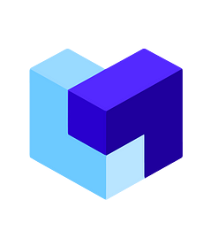








This crash course on Agentic AI starts from scratch with pre-agentic GenAI, then dives deep into Agentic AI and MCP development & deployment with TrueFoundry AI Gateway.
What You’ll Learn
Day 1: Quick Primers on Pre-Agentic GenAI
Day 2: Building Agents
Day 3: Deep-Dive into AI Gateway
Day 4: Model Context Protocol
Day 5: CI/CD and Evaluations
Certification Test
Assessments
10%
15%
15%
15%
15%
30%
Technologies Used (feel free to experiment)
+
TrueFoundry Platform
Development IDE
Agentic Search
LLM Orchestrator Framework
Vector Database
Package Manager
LangChain’s Agentic AI Framework
Prototyping UI for LLM Apps
API for Accessing Models

Slide 3
Getting Started
Notes:
Create an alternate journey slide that has the process for a platform team buyer persona
Get Numbers for the usage thing to Nikunj
In the pipeline things mention that the
Elevance – platform
Otsuka –business
Pfizer – Business Team
Medidata – both business and platform
Team slide, put team wise and some logo – only few people
Add G2 Review slide
Add Public Recognition
Elevance guy quote – Elevance thing This foundry is unlike any other foundry
Other Google review and all
Unique insights
GTM Slides pick from email
Long Term Direction Slide
Auto Pilot (Product Screenshots)
Competitors thing add
Product Deep dive explaining the product -> Modules -> One important slide and 3-4 follow up slides kinda thing
Fundraise slide – How much etc.
Ingest customer stories from throughout

Slide 4
Getting Started
Step 1: Clone the Repository
Navigate to <insert URL here>, and clone the repository <repository name>
cd <repository name> on your local system
Step 2: Setup Virtual Environment
Install uv
Create virtual environment using <uv venv>
Perform <insert different commands for activating venv for different operating systems>
Execute command <uv sync>
Step 3: Install Cursor
Install Cursor IDE and open the project
Select the correct environment
And you’re set!

Slide 5
Hands-On with LangChain and LangGraph
Notes:
Create an alternate journey slide that has the process for a platform team buyer persona
Get Numbers for the usage thing to Nikunj
In the pipeline things mention that the
Elevance – platform
Otsuka –business
Pfizer – Business Team
Medidata – both business and platform
Team slide, put team wise and some logo – only few people
Add G2 Review slide
Add Public Recognition
Elevance guy quote – Elevance thing This foundry is unlike any other foundry
Other Google review and all
Unique insights
GTM Slides pick from email
Long Term Direction Slide
Auto Pilot (Product Screenshots)
Competitors thing add
Product Deep dive explaining the product -> Modules -> One important slide and 3-4 follow up slides kinda thing
Fundraise slide – How much etc.
Ingest customer stories from throughout

Slide 6
Retrieval Augmented Generation
Notes:
Create an alternate journey slide that has the process for a platform team buyer persona
Get Numbers for the usage thing to Nikunj
In the pipeline things mention that the
Elevance – platform
Otsuka –business
Pfizer – Business Team
Medidata – both business and platform
Team slide, put team wise and some logo – only few people
Add G2 Review slide
Add Public Recognition
Elevance guy quote – Elevance thing This foundry is unlike any other foundry
Other Google review and all
Unique insights
GTM Slides pick from email
Long Term Direction Slide
Auto Pilot (Product Screenshots)
Competitors thing add
Product Deep dive explaining the product -> Modules -> One important slide and 3-4 follow up slides kinda thing
Fundraise slide – How much etc.
Ingest customer stories from throughout

Slide 7
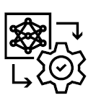
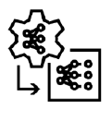


Customizing* LLMs for Tasks - Overview
Data, compute & investment
PROMPT ENGINEERING
RAG
PARAMETER-EFFICIENT FINE-TUNING
FINE TUNING
Accuracy for specific use-cases
Few-shot learning
Chain-of-thought reasoning
Least-to-most prompting
Retrieval augmented generation (RAG)
Adapters
LoRA
IA3
SFT
RLHF
TECHNIQUES
HOW
Prompt templates
Using vector databases
Add “custom” layers to LLM
Tune LLM model weights
Adapted from Nvidia Research with a few changes
*Note that this is called “finetuning” loosely, and even Prompt Engineering and RAG can be considered as finetuning for your application - a common understanding of the word “finetuning”

Slide 8
What We Know
This is how you could typically chat with an LLM:
User Prompt
LLM
Output
But how do you arm LLMs with the domain-specific / org-specific information you want it to refer to, rather than its own general training data knowledge? This is the common use case that we’ll focus on today.
User Prompt
LLM (with document information)
Output
How do you think this would work?

Slide 9
Introduction to RAG
User Prompt
LLM (with document information)
Output
Retrieval Augmented Generation (aka RAG) is how it’ll work.
Let’s expand our flow.
User Prompt
LLM
Output
GENERATION
RETRIEVAL
Similarity
Search
Context
AUGMENTATION
Knowledge Base

Slide 10
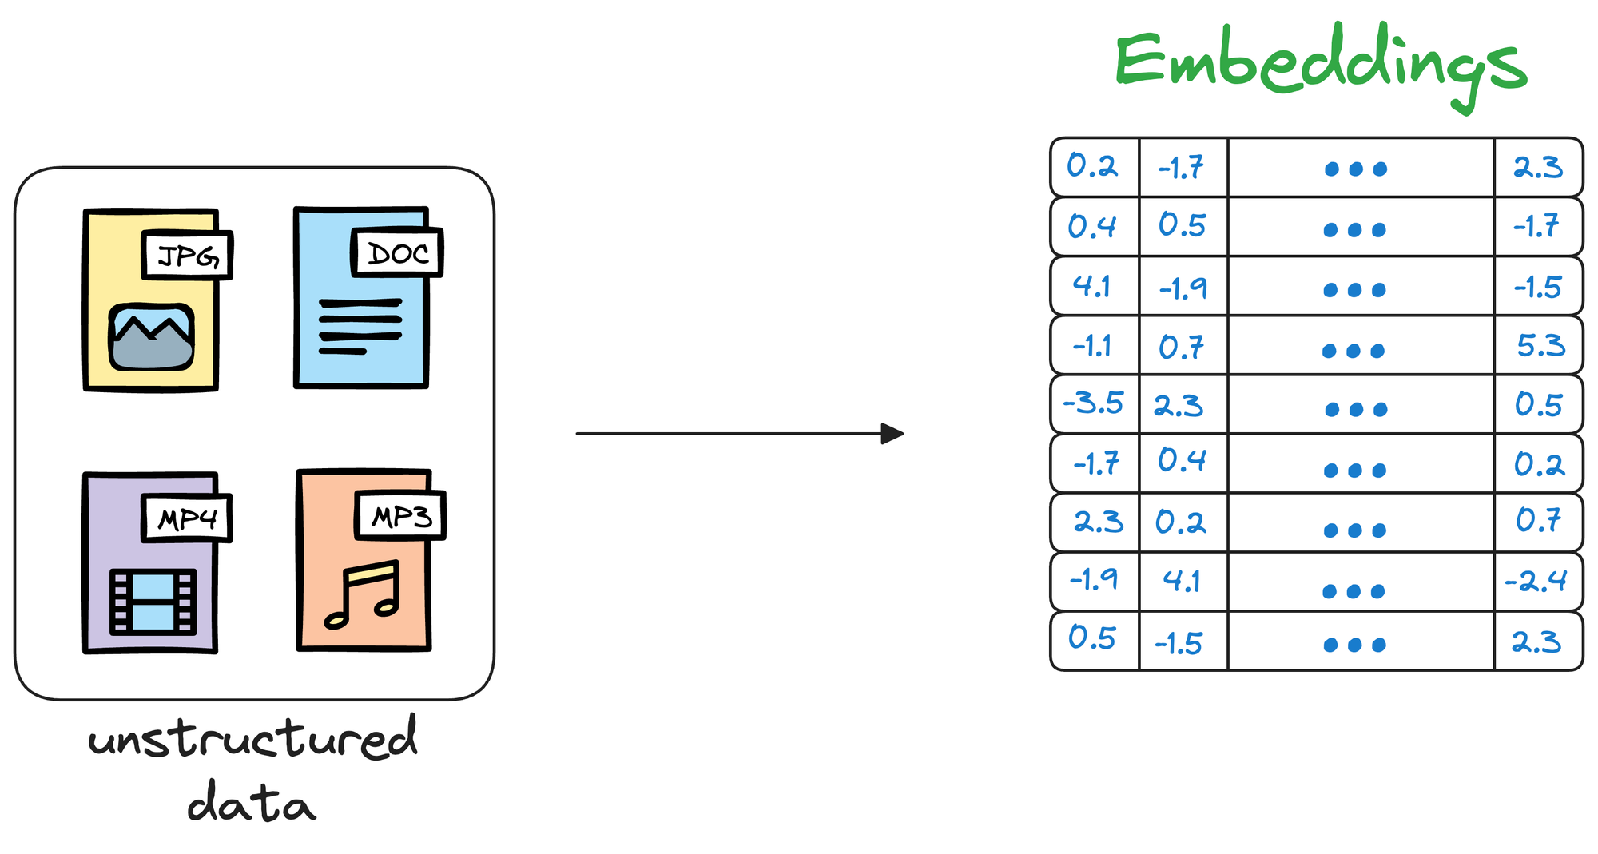
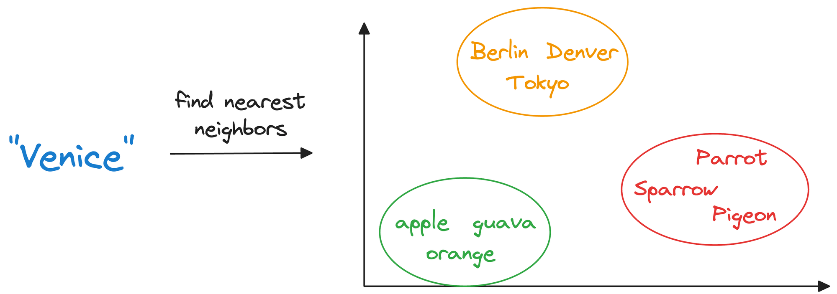
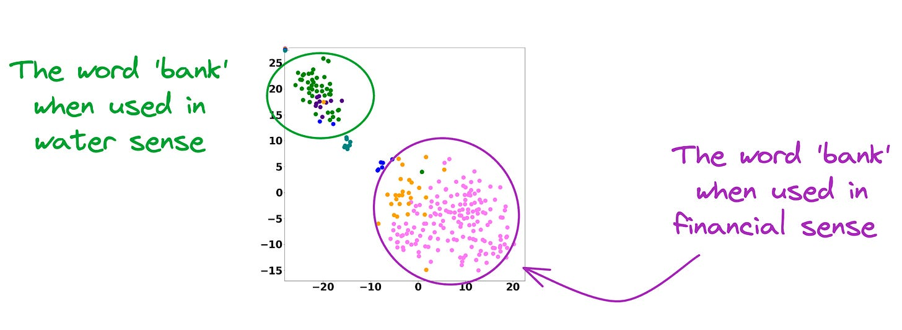
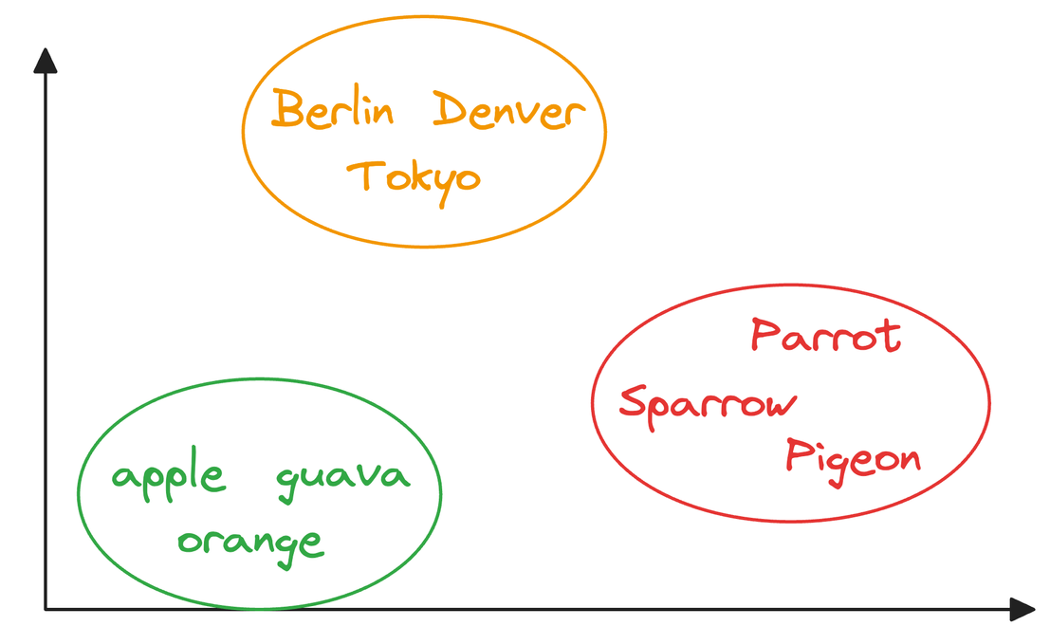
Backbone of RAG: Vector Databases
Creating a
Vector DB
At inference
Chunk and embed using an
embedding model
A vector database stores unstructured data,
in the form of vector embeddings
There are different methods by which similarity search is done
Why embedding works?
Important Note
Embeddings of similar meaning words
are near to each other→
Contextualized embedding models are used,
instead of static embedding models
Images source
Notes:
Use Chatgpt for images

Slide 11
LCMs vs RAG
Notes:
Create an alternate journey slide that has the process for a platform team buyer persona
Get Numbers for the usage thing to Nikunj
In the pipeline things mention that the
Elevance – platform
Otsuka –business
Pfizer – Business Team
Medidata – both business and platform
Team slide, put team wise and some logo – only few people
Add G2 Review slide
Add Public Recognition
Elevance guy quote – Elevance thing This foundry is unlike any other foundry
Other Google review and all
Unique insights
GTM Slides pick from email
Long Term Direction Slide
Auto Pilot (Product Screenshots)
Competitors thing add
Product Deep dive explaining the product -> Modules -> One important slide and 3-4 follow up slides kinda thing
Fundraise slide – How much etc.
Ingest customer stories from throughout

Slide 12
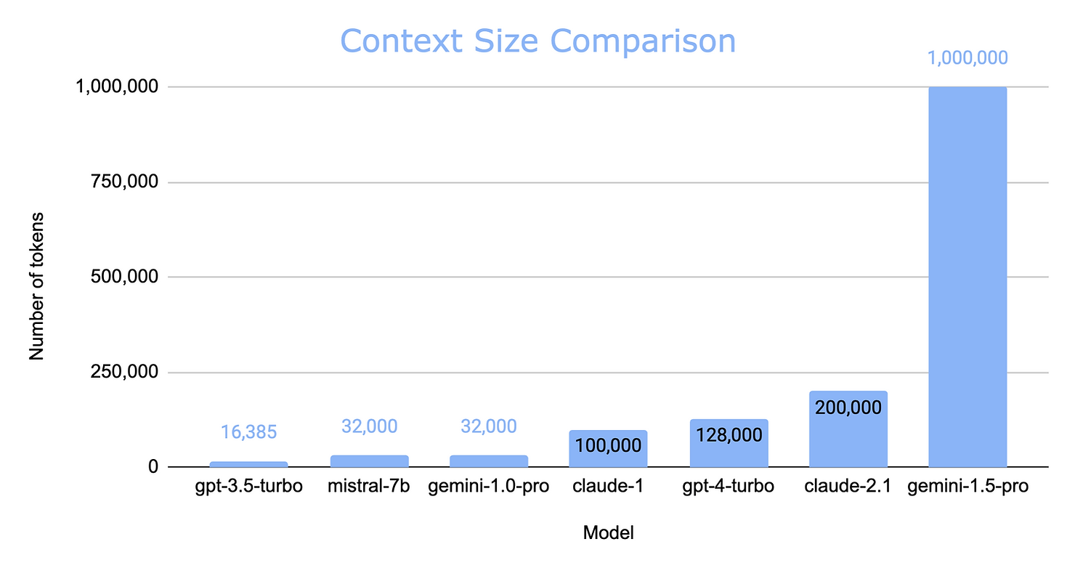
Increased Context Length – RAG still relevant?
Large Context Model
Source

Slide 13
Increased Context Length – RAG still relevant?
Cost: Large Context Models (LRAG winsCMs) like Gemini 1.5 are expensive per token, making RAG models more cost-effective for most use cases.!
Latency: LCMs take longer to process longer contexts. RAG models can achieve lower latency with smaller contexts. RAG wins!
Context Learning: LCMs excel at complex reasoning and learning from long contexts, demonstrated by reasoning about Apollo 11 transcripts and learning new skills. LCMs win!
Long Context Recall: LCMs may struggle with recalling information in the middle of long contexts. RAG models can curate relevant content before feeding it to the LLM. RAG wins!
Flexibility & Customization: RAG models offer more control over data sources and retrieval strategies, making them more customizable. LCMs are a faster solution but less flexible. RAG wins!
Security & Data Privacy: RAG models provide more control over data privacy, especially for self-hosted deployments. LCMs rely on an external provider's security measures. RAG wins!
Conclusion: RAG is here to stay!
Source

Slide 14
Improving RAG Systems
Notes:
Create an alternate journey slide that has the process for a platform team buyer persona
Get Numbers for the usage thing to Nikunj
In the pipeline things mention that the
Elevance – platform
Otsuka –business
Pfizer – Business Team
Medidata – both business and platform
Team slide, put team wise and some logo – only few people
Add G2 Review slide
Add Public Recognition
Elevance guy quote – Elevance thing This foundry is unlike any other foundry
Other Google review and all
Unique insights
GTM Slides pick from email
Long Term Direction Slide
Auto Pilot (Product Screenshots)
Competitors thing add
Product Deep dive explaining the product -> Modules -> One important slide and 3-4 follow up slides kinda thing
Fundraise slide – How much etc.
Ingest customer stories from throughout

Slide 15
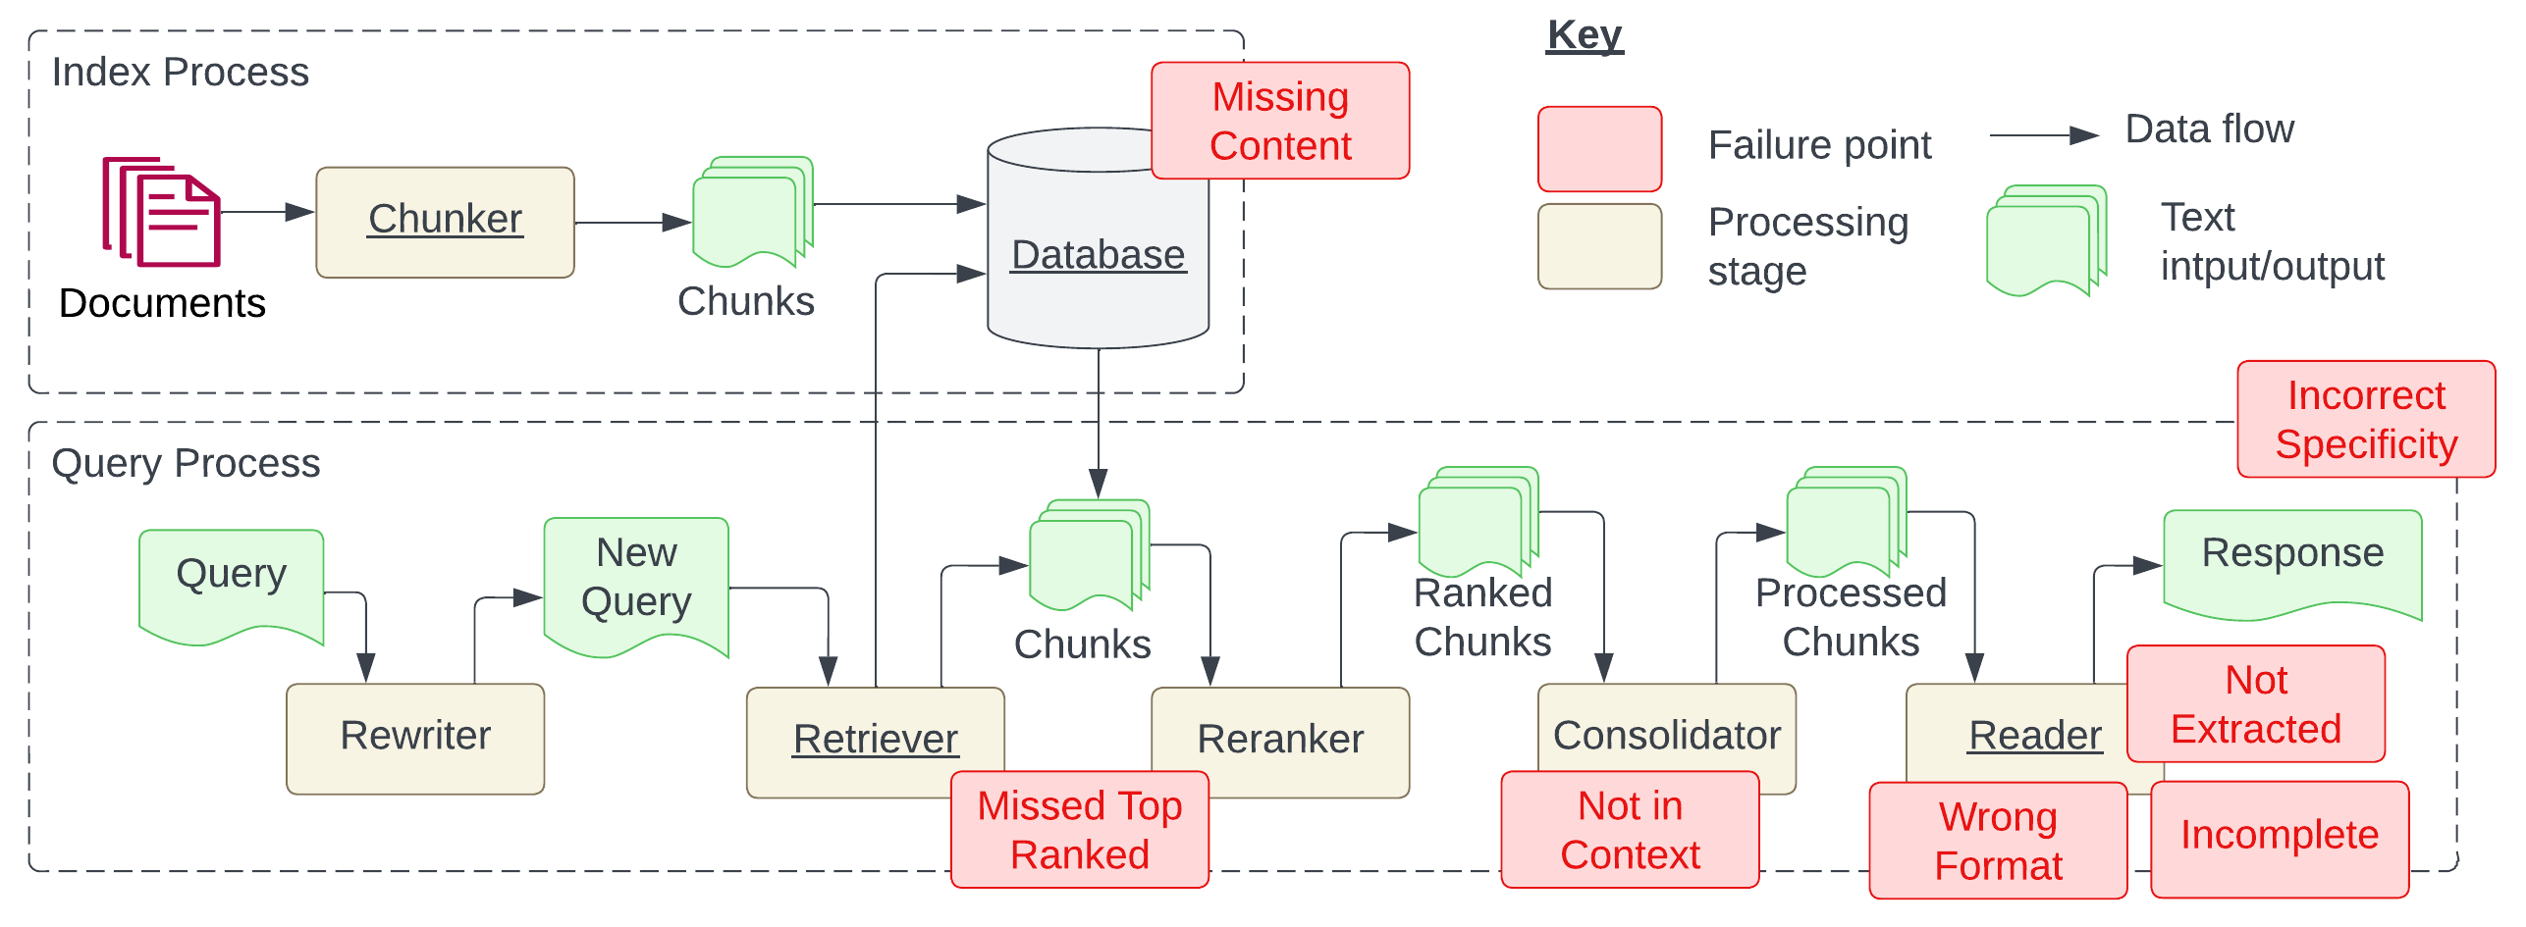
Key Failure Points of a RAG System
FP 1
Question is related to content, but there’s no information to answer
FP 6
Answer returned is too specific, or too vague
FP 4
LLM didn’t extract answer from context
FP 3
FP 5
FP 7
FP 2
Answer is available in document, but did not rank within the top K
Relevant documents with answer were retrieved, but didn’t make it to context
LLM ignored instruction regarding format
LLM returns incomplete answers, though information is in context
Source: Seven Failure Points When Engineering a RAG System (arXiv)
Notes:
Self-organizing maps
What are variational autoencoders

Slide 16
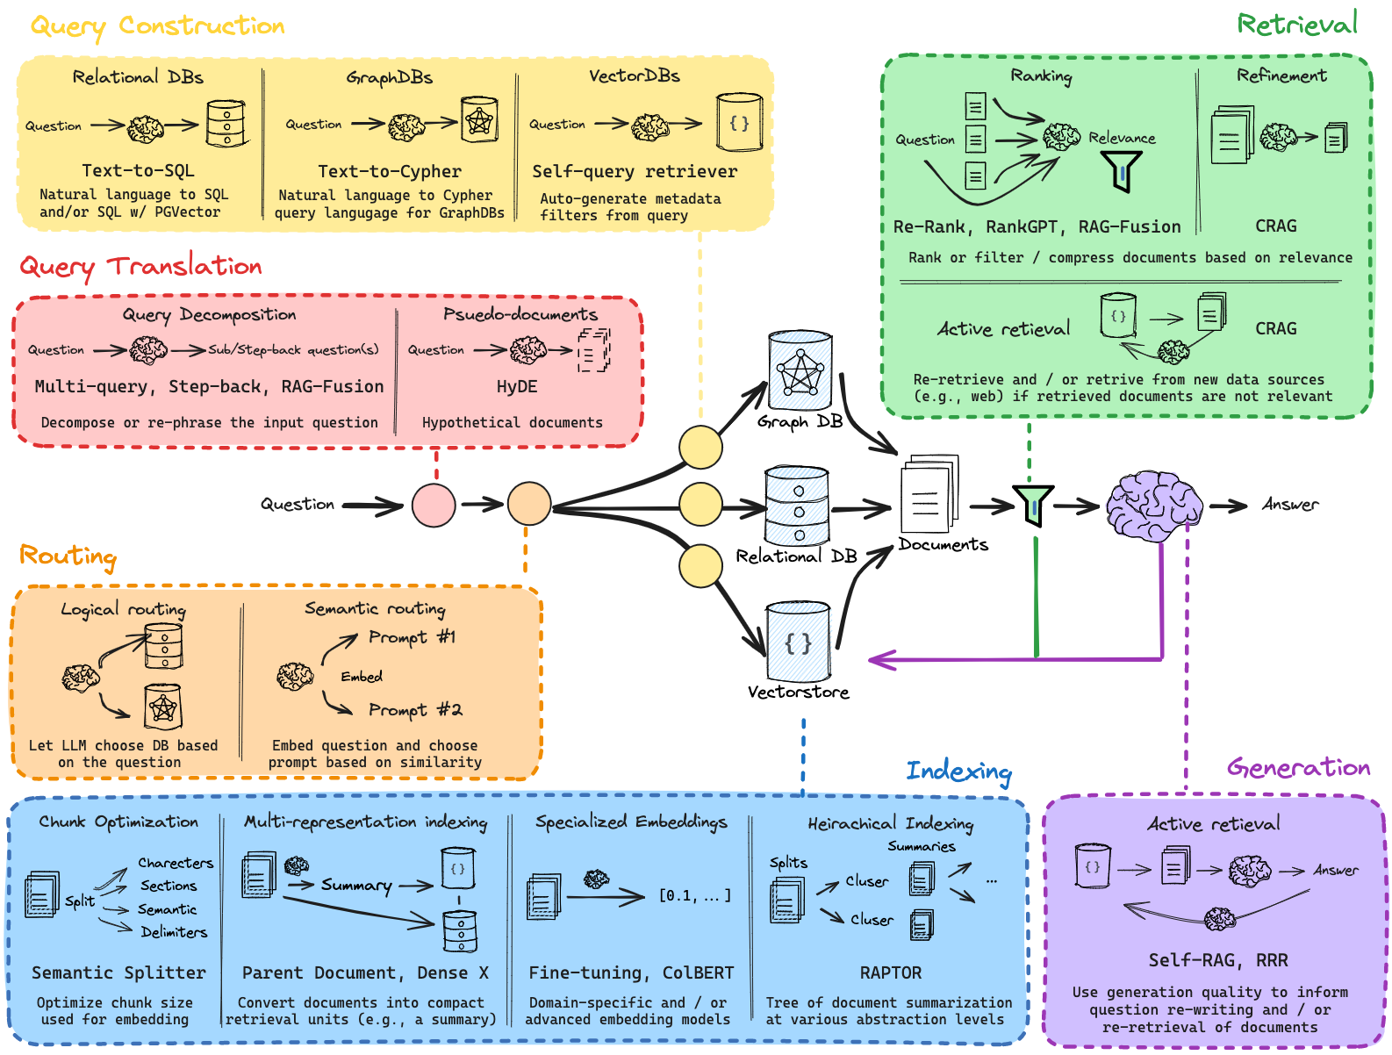
Methods to Improve RAG
Assuming prompts and choice of LLM are optimized for,
we’re optimizing for RAG!
Sourced from LangChain AI’s GitHub Repo here
Notes:
Self-organizing maps
What are variational autoencoders

Slide 17
Multimodal RAG
Notes:
Create an alternate journey slide that has the process for a platform team buyer persona
Get Numbers for the usage thing to Nikunj
In the pipeline things mention that the
Elevance – platform
Otsuka –business
Pfizer – Business Team
Medidata – both business and platform
Team slide, put team wise and some logo – only few people
Add G2 Review slide
Add Public Recognition
Elevance guy quote – Elevance thing This foundry is unlike any other foundry
Other Google review and all
Unique insights
GTM Slides pick from email
Long Term Direction Slide
Auto Pilot (Product Screenshots)
Competitors thing add
Product Deep dive explaining the product -> Modules -> One important slide and 3-4 follow up slides kinda thing
Fundraise slide – How much etc.
Ingest customer stories from throughout

Slide 18
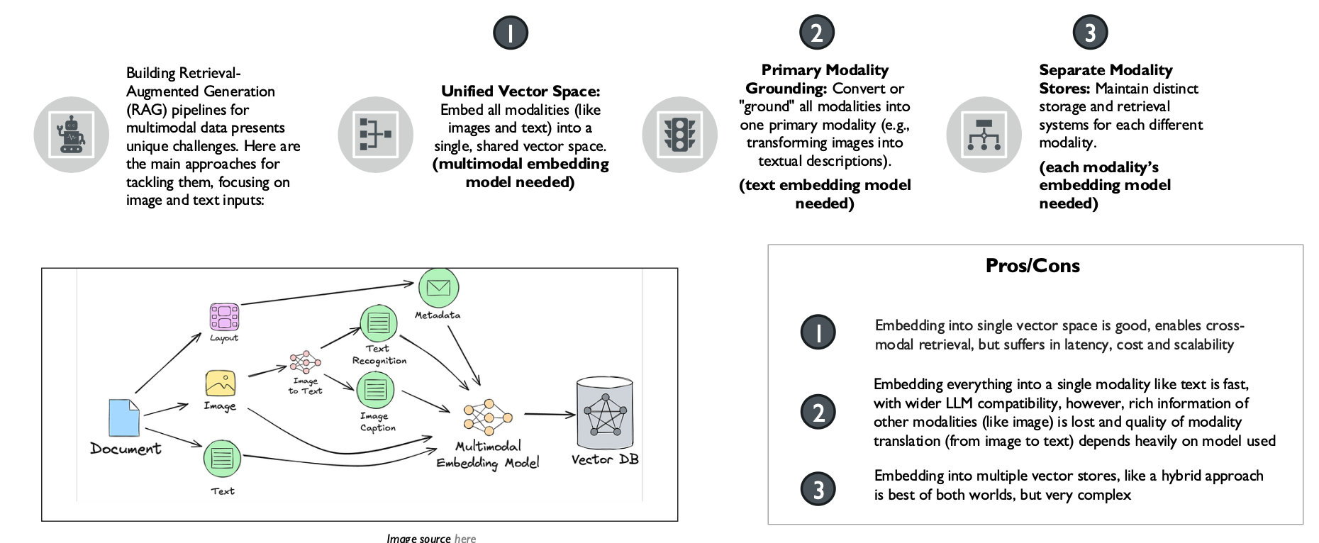
Multimodal RAG

Slide 19
Hands-On with RAG
Notes:
Create an alternate journey slide that has the process for a platform team buyer persona
Get Numbers for the usage thing to Nikunj
In the pipeline things mention that the
Elevance – platform
Otsuka –business
Pfizer – Business Team
Medidata – both business and platform
Team slide, put team wise and some logo – only few people
Add G2 Review slide
Add Public Recognition
Elevance guy quote – Elevance thing This foundry is unlike any other foundry
Other Google review and all
Unique insights
GTM Slides pick from email
Long Term Direction Slide
Auto Pilot (Product Screenshots)
Competitors thing add
Product Deep dive explaining the product -> Modules -> One important slide and 3-4 follow up slides kinda thing
Fundraise slide – How much etc.
Ingest customer stories from throughout

Slide 20
Assessment (10%)

Slide 21
Introduction to Agents
Notes:
Create an alternate journey slide that has the process for a platform team buyer persona
Get Numbers for the usage thing to Nikunj
In the pipeline things mention that the
Elevance – platform
Otsuka –business
Pfizer – Business Team
Medidata – both business and platform
Team slide, put team wise and some logo – only few people
Add G2 Review slide
Add Public Recognition
Elevance guy quote – Elevance thing This foundry is unlike any other foundry
Other Google review and all
Unique insights
GTM Slides pick from email
Long Term Direction Slide
Auto Pilot (Product Screenshots)
Competitors thing add
Product Deep dive explaining the product -> Modules -> One important slide and 3-4 follow up slides kinda thing
Fundraise slide – How much etc.
Ingest customer stories from throughout

Slide 22
Why LLMs Alone Fall Short
LLMs can think, but not act
LLMs are limited by what’s available in their training data
There is a single inference basis the user query, and no continuous context management (i.e., chat history)

Slide 23
What We Need Instead
LLMs can think, but not act
Need to be able to to perform actions like making an API call
LLMs are limited by what’s available in their training data
Need to extend knowledge through connection with external systems such as search tools
There is a single inference basis the user query, and no continuous context management (i.e., chat history)
Need to have a managed session history, which allows for multi-turn conversations

Slide 24
The Augmented LLM
The basic idea is to augment the LLM with retrieval, tools and memory, where they can generate their own search queries, select appropriate tools and determine what information to retain.
User Prompt
LLM
Output
Query/Results
Read/Write
Call/Response
Retrieval
Memory
Tools
The Augmented LLM

Slide 25
Agents vs. Workflows
Workflows are systems where LLMs and tools are orchestrated through predefined code paths
Agents are dynamic systems where LLMs direct their own processes and tool usage, maintaining control over how they accomplish tasks (i.e., LLM controls execution logic)
Both are characterized as “Agentic AI systems”, however the architectural difference exists!
Capability | Workflow | Agent
Augmented LLMs | Yes | Yes
Control Flow | Fixed, pre-defined | Dynamic
Costs | Predictable | More unpredictable

Slide 26
Agentic AI: Workflows
Notes:
Create an alternate journey slide that has the process for a platform team buyer persona
Get Numbers for the usage thing to Nikunj
In the pipeline things mention that the
Elevance – platform
Otsuka –business
Pfizer – Business Team
Medidata – both business and platform
Team slide, put team wise and some logo – only few people
Add G2 Review slide
Add Public Recognition
Elevance guy quote – Elevance thing This foundry is unlike any other foundry
Other Google review and all
Unique insights
GTM Slides pick from email
Long Term Direction Slide
Auto Pilot (Product Screenshots)
Competitors thing add
Product Deep dive explaining the product -> Modules -> One important slide and 3-4 follow up slides kinda thing
Fundraise slide – How much etc.
Ingest customer stories from throughout

Slide 27
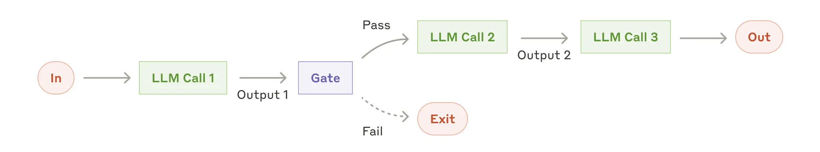
Workflow: Prompt Chaining
Goal: Decompose into fixed sub-tasks; any programmatic checks can be added to ensure process is on track
When to Use: Where task can be easily and cleanly decomposed into fixed subtasks
Use Cases:
Generate marketing copy, then translate to different languages
Write outline of document, check if it meets specific criteria, then write document
Reference: Anthropic

Slide 28
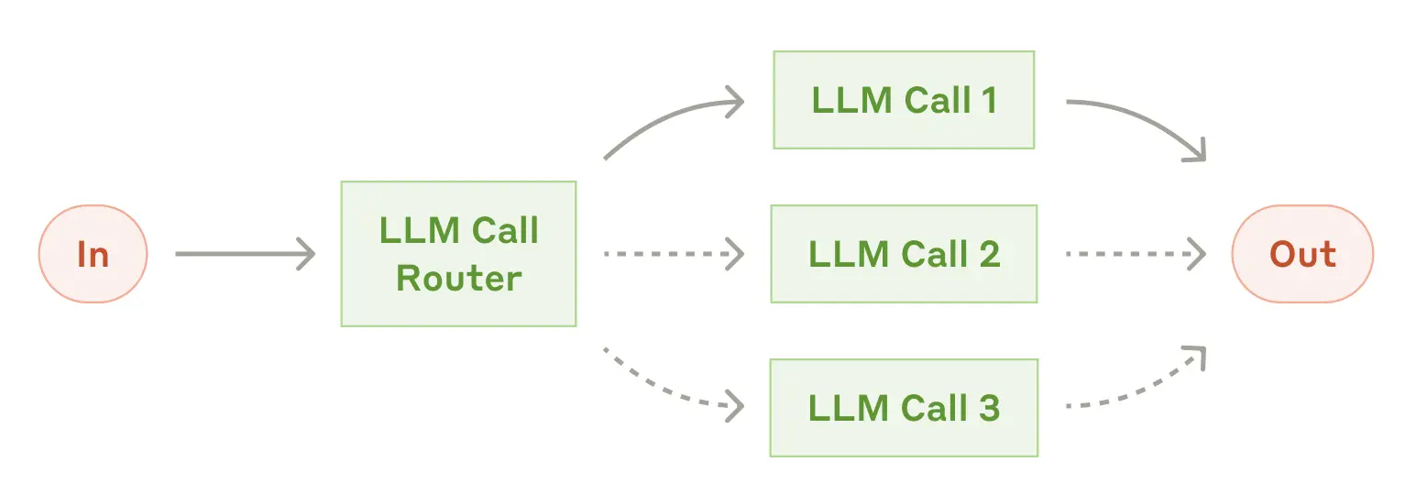
Workflow: Routing
Goal: Direct an input into a specialized sub-task, ensuring separation of concerns
When to Use: Where distinct categories of tasks are better handled separately, and category classification is easy
Use Cases:
Directing customer service queries (general questions, refund requests, technical support)
Routing questions based on complexity to smaller/more capable models, to optimize cost and speed
Reference: Anthropic

Slide 29
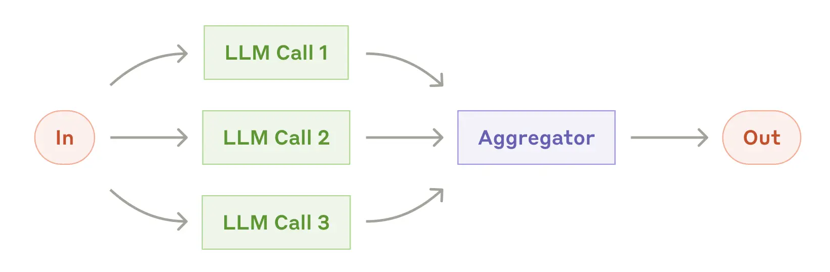
Workflow: Parallelization (Sectioning)
Goal: Breaking down into different tasks and running multiple subtasks concurrently, post which aggregation is done.
When to Use: Where complex tasks can be broken down and parallelized for speed
Use Cases:
Guardrails, where one model instance processes user query and another screens for inappropriate requests
Automating evals, where each LLM call evaluates a different aspect of performance
Reference: Anthropic

Slide 30
Workflow: Parallelization (Voting)
Goal: Running same task multiple times concurrently to get diverse outputs, post which voting is done
When to Use: Where higher confidence in the output is needed
Use Cases:
Reviewing a piece of code for vulnerabilities
Evaluating whether a given piece of content is inappropriate, with different thresholds to balance false positives and negatives.
Reference: Anthropic

Slide 31
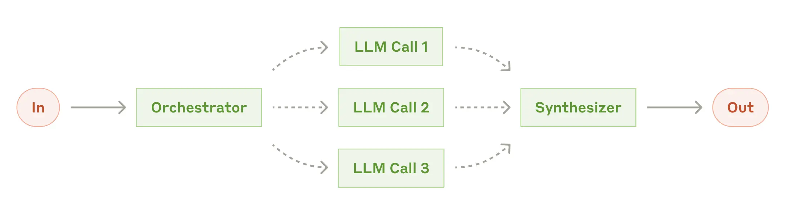
Workflow: Orchestrator-Worker
Goal: Complex tasks are broken down dynamically and combined
When to Use: Where subtasks can’t be predicted, but need to be determined (also allows for more flexibility)
Use Cases:
Search tasks that involve gathering and analyzing information from many sources
Reference: Anthropic

Slide 32
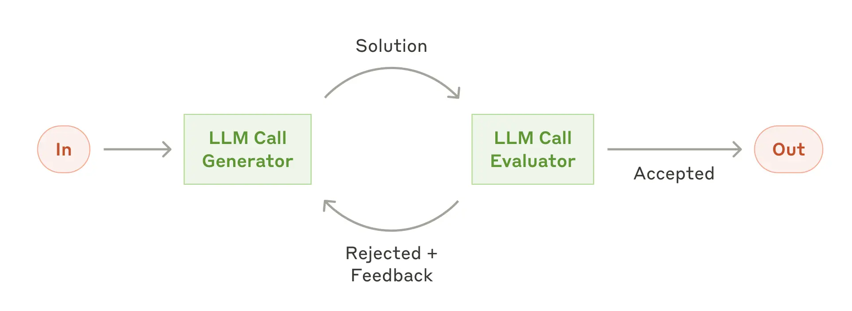
Workflow: Evaluator-Optimizer
Goal: LLM output is validated by another
When to Use: Where 1) LLM responses can be clearly evaluated (via criteria), 2) human feedback significantly improves LLM responses iteratively, and 3) whether LLM can provide such feedbacks
Use Cases:
Literary translation, where translator LLM responses can be improved with evaluator LLM’s critiques
Complex search tasks where evaluator decides whether further searches are needed
Reference: Anthropic

Slide 33
Agentic AI: Agents
Notes:
Create an alternate journey slide that has the process for a platform team buyer persona
Get Numbers for the usage thing to Nikunj
In the pipeline things mention that the
Elevance – platform
Otsuka –business
Pfizer – Business Team
Medidata – both business and platform
Team slide, put team wise and some logo – only few people
Add G2 Review slide
Add Public Recognition
Elevance guy quote – Elevance thing This foundry is unlike any other foundry
Other Google review and all
Unique insights
GTM Slides pick from email
Long Term Direction Slide
Auto Pilot (Product Screenshots)
Competitors thing add
Product Deep dive explaining the product -> Modules -> One important slide and 3-4 follow up slides kinda thing
Fundraise slide – How much etc.
Ingest customer stories from throughout

Slide 34
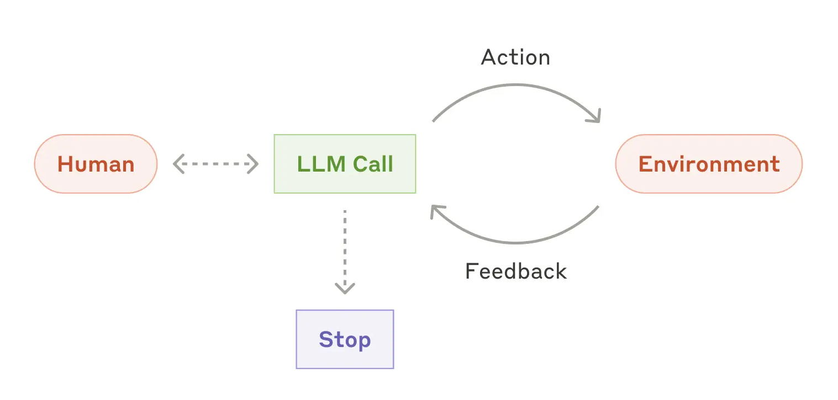
In contrast, Agents -
Goal: With more advanced LLM capabilities (understanding complex inputs, engaging in reasoning and planning, using tools reliably, and recovering from errors), plan and operate independently while returning to human for feedback
When to Use: For open-ended problems, where it’s difficult to predict required number of steps or find a fixed path
Many Use Cases (complex)
Customer support (talk, pull data, act, resolve)
Coding agents (design, build, test, measure)
Reference - Anthropic

Slide 35
Agents
Goal: With more advanced LLM capabilities (understanding complex inputs, engaging in reasoning and planning, using tools reliably, and recovering from errors), plan and operate independently while returning to human for feedback
When to Use: For open-ended problems, where it’s difficult to predict required number of steps or find a fixed path
Many Use Cases (complex)
Customer support (talk, pull data, act, resolve)
Coding agents (design, build, test, measure)
Reference - Anthropic

Slide 36
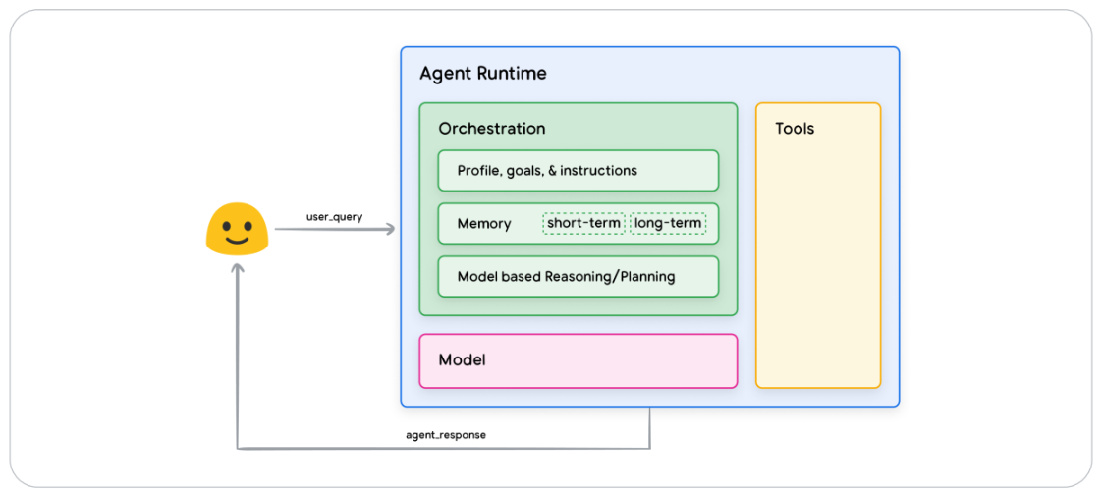
What constitutes an AI Agent
Agents are AI systems that leverage LLMs to reason through a solution, leveraging external tools, planning (like reflection and task decomposition), and having memory (short-term or long-term).
Source: Google’s Agents Whitepaper

Slide 37
Deeper into Tools
Notes:
Create an alternate journey slide that has the process for a platform team buyer persona
Get Numbers for the usage thing to Nikunj
In the pipeline things mention that the
Elevance – platform
Otsuka –business
Pfizer – Business Team
Medidata – both business and platform
Team slide, put team wise and some logo – only few people
Add G2 Review slide
Add Public Recognition
Elevance guy quote – Elevance thing This foundry is unlike any other foundry
Other Google review and all
Unique insights
GTM Slides pick from email
Long Term Direction Slide
Auto Pilot (Product Screenshots)
Competitors thing add
Product Deep dive explaining the product -> Modules -> One important slide and 3-4 follow up slides kinda thing
Fundraise slide – How much etc.
Ingest customer stories from throughout

Slide 38
Tools and Function Calling
Function calling in Large Language Models (LLMs) enables these models to interact with external tools and APIs, thereby extending their capabilities beyond text generation to include real-time data retrieval

Slide 39
Tools and Function Calling
The function-calling feature is implemented using a combination of fine-tuning, prompt engineering, and structured output generation techniques.
Finetuning: Teach the LLM to call functions, by showing it examples of user query – correct function
Prompt Engineering: Include the function's name, a description of what it does, and a list of its required parameters and their data types
Structured Output Generation: LLM should generate a structured output, typically a JSON, containing the function’s name and specific arguments needed
Note: Prompt engineering tools is as important as overall prompt engineering, as agents often fail at their tasks when they don’t call tools the right way!

Slide 40
Tools and Function Calling
Primary use cases that leverage function calling:
Agents
For example, if you say, "What's the weather like in Boston?", the LLM can decide that it needs a weather API to get the answer. It then generates a structured function call (e.g., get_weather(location="Boston")), which your application executes. The results from that API are then sent back to the LLM, which uses them to formulate a natural language response like, "The weather in Boston is currently sunny and 75°F.”
Complex multi-turn chatbots
By using function calls, the chatbot can "write" to a memory or database and "read" from it in subsequent turns.
Batch inference feature extraction
For example, you could have millions of customer reviews and use an LLM with a function-calling capability to extract key information like product_name, sentiment (positive/negative), and key_complaint.
Structured output generation
In general!

Slide 41
Tools and Function Calling
Not all LLMs are made the same, and LLMs differ in their capabilities to call the right tools
Berkeley Function-Calling Leaderboard

Slide 42
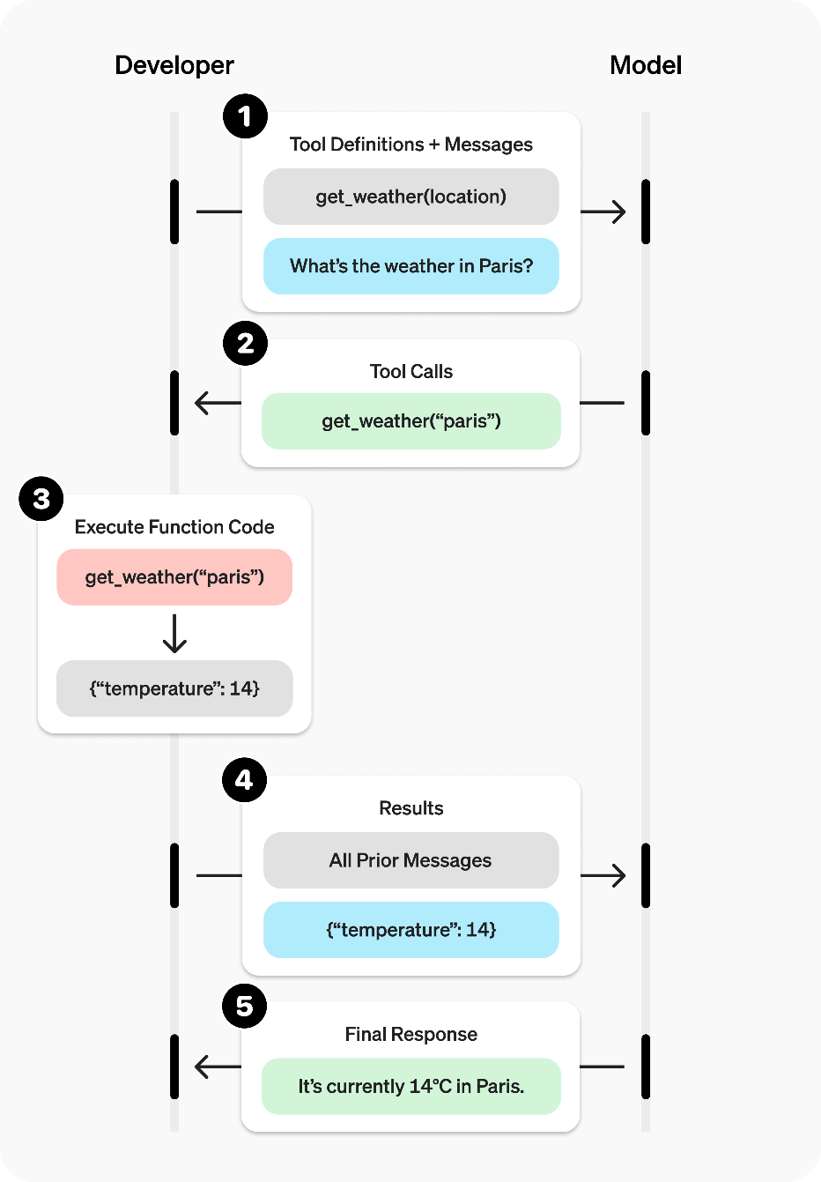
Tools and Function Calling
How the Execution Happens
Image Source: OpenAI

Slide 43
Agentic Design Patterns
Notes:
Create an alternate journey slide that has the process for a platform team buyer persona
Get Numbers for the usage thing to Nikunj
In the pipeline things mention that the
Elevance – platform
Otsuka –business
Pfizer – Business Team
Medidata – both business and platform
Team slide, put team wise and some logo – only few people
Add G2 Review slide
Add Public Recognition
Elevance guy quote – Elevance thing This foundry is unlike any other foundry
Other Google review and all
Unique insights
GTM Slides pick from email
Long Term Direction Slide
Auto Pilot (Product Screenshots)
Competitors thing add
Product Deep dive explaining the product -> Modules -> One important slide and 3-4 follow up slides kinda thing
Fundraise slide – How much etc.
Ingest customer stories from throughout

Slide 44
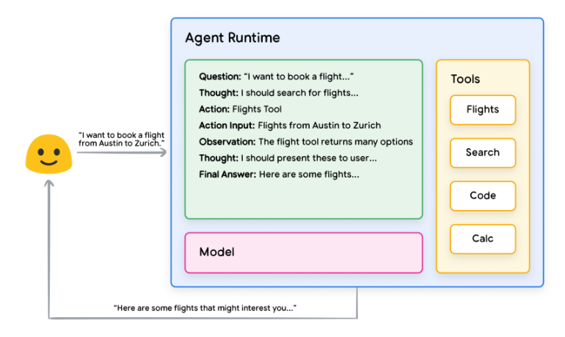
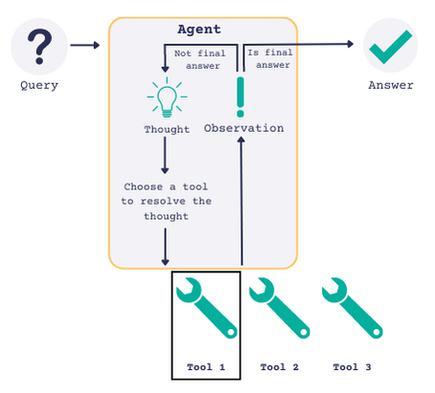
The Simplest Form of Agent: ReACT Agent
The ReAct (Reasoning and Action) agent model
Integrates the reasoning capabilities of large language models (LLMs) with the ability to take actionable steps
Creates a more sophisticated system that can understand and process information
Can evaluate situations, take appropriate actions, communicate responses, and track ongoing situations.
ReAct: Synergizing Reasoning and Acting in Language Models

Slide 45
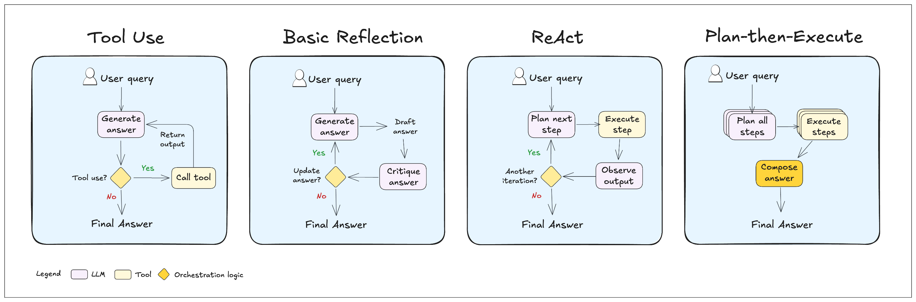
Some Single-Agent Design Patterns
Image Source

Slide 46
When Single-Agent Systems Fall Short
Overloaded Agents: A single agent can struggle to make good decisions when it has access to too many tools, leading to poor performance.
Complex Context: A single agent can have difficulty managing a large or complex conversational context, causing it to lose track of the user's request.
Lack of Specialization: A single agent isn't equipped to handle a wide range of tasks that require different skills, like planning, research, and mathematical expertise.

Slide 47
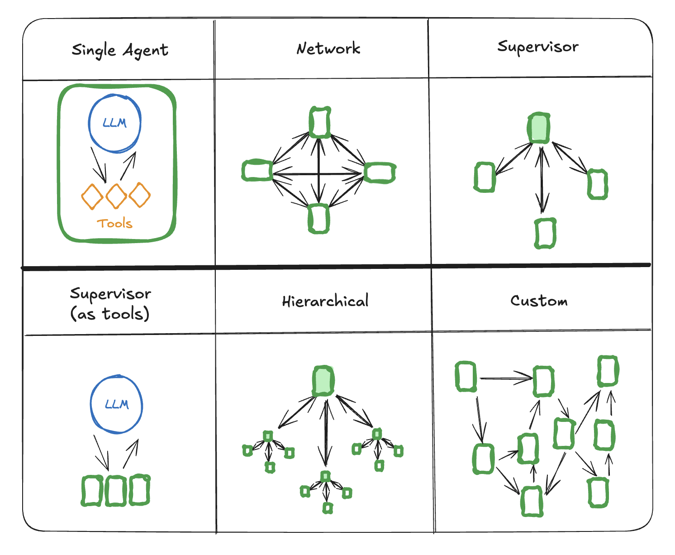
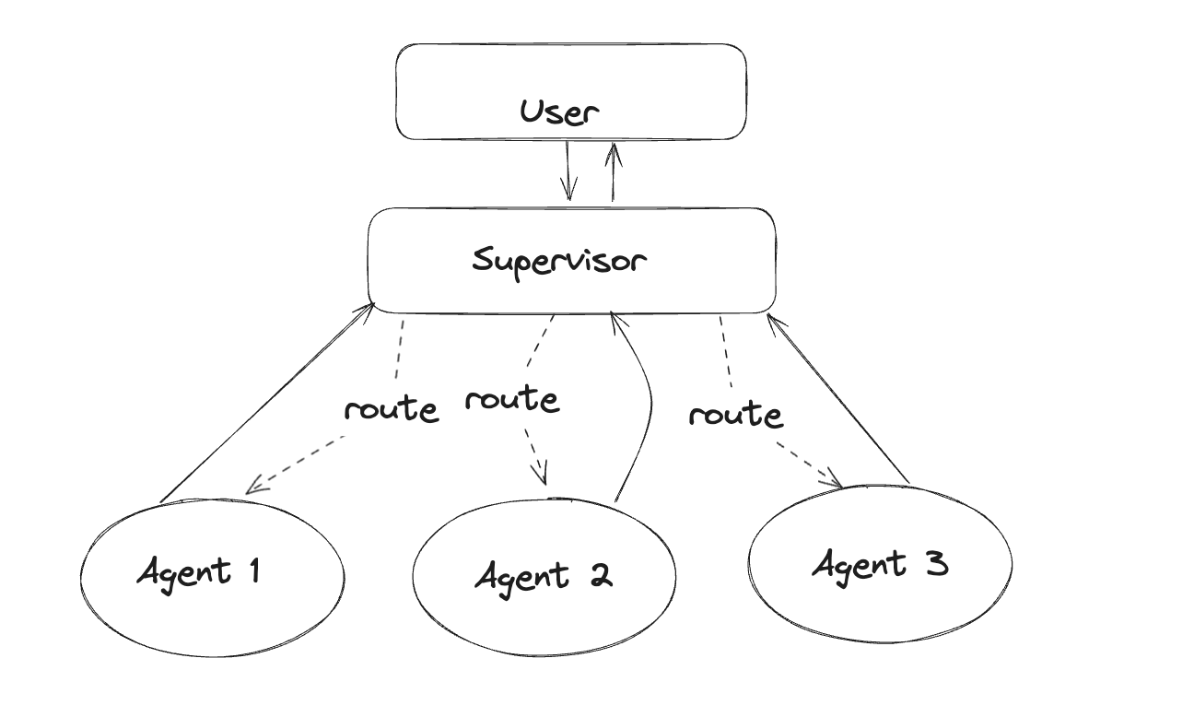
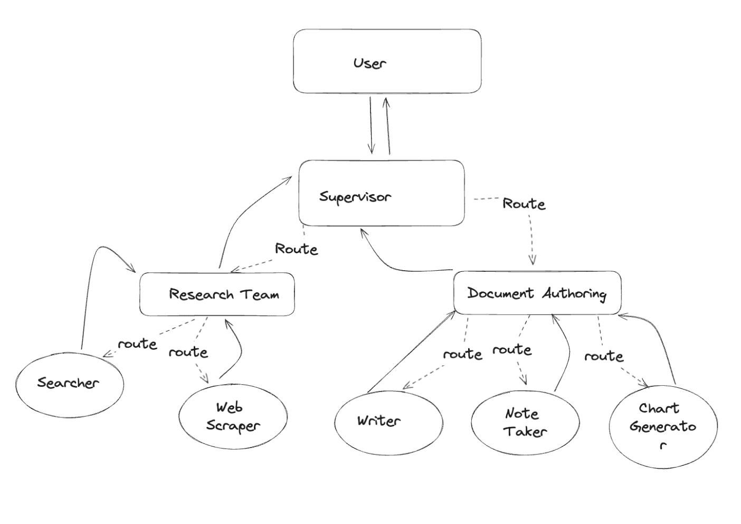
Multi-Agent Design Patterns
Reference - LangChain

Slide 48
Guidelines and Considerations
Notes:
Create an alternate journey slide that has the process for a platform team buyer persona
Get Numbers for the usage thing to Nikunj
In the pipeline things mention that the
Elevance – platform
Otsuka –business
Pfizer – Business Team
Medidata – both business and platform
Team slide, put team wise and some logo – only few people
Add G2 Review slide
Add Public Recognition
Elevance guy quote – Elevance thing This foundry is unlike any other foundry
Other Google review and all
Unique insights
GTM Slides pick from email
Long Term Direction Slide
Auto Pilot (Product Screenshots)
Competitors thing add
Product Deep dive explaining the product -> Modules -> One important slide and 3-4 follow up slides kinda thing
Fundraise slide – How much etc.
Ingest customer stories from throughout

Slide 49
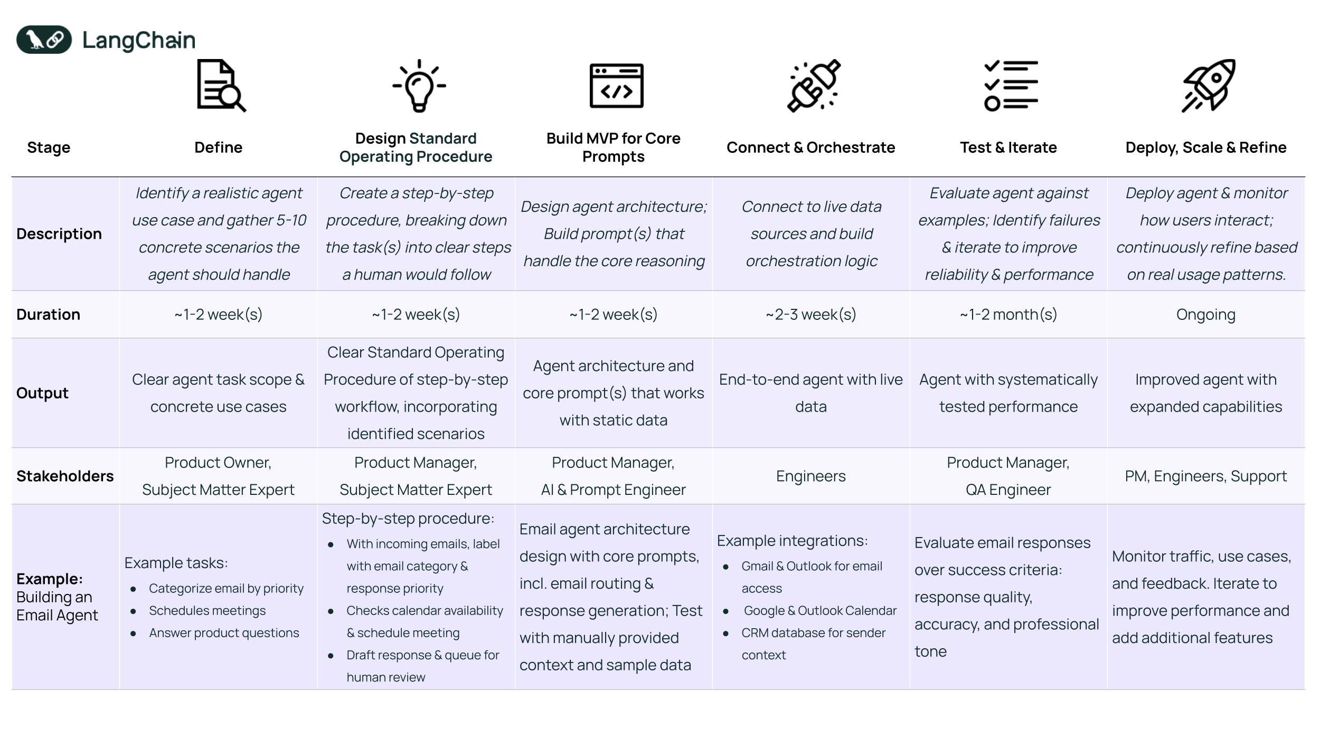
General Guidelines for Building Agents
Reference - LangChain

Slide 50
Considerations When Building Agents
Risks
Unpredictable path
Unpredictable output
Unpredictable costs
The Need to Monitor
Guardrails: they ensure agents behave safely, consistently and within intended boundaries
Cost, Latency, Tracing etc.
Enter AI Gateway as a one-stop solution!
Recommendation
Build the right system, not always the most sophisticated one
Start with simple prompts, optimize with evaluation, then go to multi-step agentic systems
Reference - Anthropic

Slide 51
Hands-On with Agents
Notes:
Create an alternate journey slide that has the process for a platform team buyer persona
Get Numbers for the usage thing to Nikunj
In the pipeline things mention that the
Elevance – platform
Otsuka –business
Pfizer – Business Team
Medidata – both business and platform
Team slide, put team wise and some logo – only few people
Add G2 Review slide
Add Public Recognition
Elevance guy quote – Elevance thing This foundry is unlike any other foundry
Other Google review and all
Unique insights
GTM Slides pick from email
Long Term Direction Slide
Auto Pilot (Product Screenshots)
Competitors thing add
Product Deep dive explaining the product -> Modules -> One important slide and 3-4 follow up slides kinda thing
Fundraise slide – How much etc.
Ingest customer stories from throughout

Slide 52
Comparison of Popular Agentic AI Frameworks
Choose LangGraph if: You need precise control over complex, looping workflows and robust state management for production.
Choose CrewAI if: You want to model collaborative teams of AI agents with distinct roles and intuitive interaction.
Choose AutoGen if: You need highly flexible agent conversations, especially for code-centric problem-solving and iterative tasks.
Feature/Framework | LangGraph | CrewAI | AutoGen
Core Idea | Graph-based workflows, powerful state management for complex cycles. | Role-based multi-agent systems for intuitive collaboration. | Flexible conversation patterns and agent topologies.
Best For | Complex, cyclical processes; human-in-the-loop; production-ready applications. | Team-based workflows; automated customer support, research, or development. | Complex problem-solving; code generation & debugging; diverse agent interactions.
Key Strength | Superior state control & flow; highly customizable; production-grade. | Intuitive collaborative intelligence; clear role delegation. | Flexible conversational dynamics; strong code execution & debugging.
Learning Curve | Steeper (graphs & state) | Medium | Medium
Scalability | High (built for production) | Medium-High | Medium-High
Tooling | Strong via LangChain | Flexible custom tools | Strong (code execution, APIs)

Slide 53
Assessment (15%)
Notes:
Create an alternate journey slide that has the process for a platform team buyer persona
Get Numbers for the usage thing to Nikunj
In the pipeline things mention that the
Elevance – platform
Otsuka –business
Pfizer – Business Team
Medidata – both business and platform
Team slide, put team wise and some logo – only few people
Add G2 Review slide
Add Public Recognition
Elevance guy quote – Elevance thing This foundry is unlike any other foundry
Other Google review and all
Unique insights
GTM Slides pick from email
Long Term Direction Slide
Auto Pilot (Product Screenshots)
Competitors thing add
Product Deep dive explaining the product -> Modules -> One important slide and 3-4 follow up slides kinda thing
Fundraise slide – How much etc.
Ingest customer stories from throughout

Slide 54
Deep-Dive into TrueFoundry AI Gateway
Notes:
Create an alternate journey slide that has the process for a platform team buyer persona
Get Numbers for the usage thing to Nikunj
In the pipeline things mention that the
Elevance – platform
Otsuka –business
Pfizer – Business Team
Medidata – both business and platform
Team slide, put team wise and some logo – only few people
Add G2 Review slide
Add Public Recognition
Elevance guy quote – Elevance thing This foundry is unlike any other foundry
Other Google review and all
Unique insights
GTM Slides pick from email
Long Term Direction Slide
Auto Pilot (Product Screenshots)
Competitors thing add
Product Deep dive explaining the product -> Modules -> One important slide and 3-4 follow up slides kinda thing
Fundraise slide – How much etc.
Ingest customer stories from throughout

Slide 55
Reuse YouTube Video for an Introduction
Notes:
An AI Gateway is a specialized middle layer that sits between your applications and the various AI models you use. It acts as a single, intelligent control point for all your AI traffic – managing everything like security, observability and governance, and thus makes it simple to scale GenAI apps reliably.
Architecturally, the AI Gateway is designed to solve the pain points we discussed by being a centralized layer. It simplifies your infrastructure by decoupling your applications from your external or internal AI services – this can self-hosted or proprietary LLMs or even MCP servers. This means your developers code to a single API endpoint, and the gateway handles the complexity behind the scenes. This centralized design is how you gain control over everything—from managing costs and security to ensuring reliability and performance.
Now let’s understand it visually. What’s happening here is that the AI gateway receives an API call from an application and then processes it before sending it to the correct LLM. This process can involve routing to appropriate model, or, translating the request from the application's format into the specific API format required by the target model, or adding necessary API keys or tokens required by specific LLM for authentication and authorization, or caching to check if a similar request has been made before to return a cached response to save time and money without needing to call the LLM again.
In essence, the AI gateway transforms a generic API call into a model-specific API request, acting as a bridge.

Slide 56
Hands-on Demo of TrueFoundry AI Gateway
Notes:
Create an alternate journey slide that has the process for a platform team buyer persona
Get Numbers for the usage thing to Nikunj
In the pipeline things mention that the
Elevance – platform
Otsuka –business
Pfizer – Business Team
Medidata – both business and platform
Team slide, put team wise and some logo – only few people
Add G2 Review slide
Add Public Recognition
Elevance guy quote – Elevance thing This foundry is unlike any other foundry
Other Google review and all
Unique insights
GTM Slides pick from email
Long Term Direction Slide
Auto Pilot (Product Screenshots)
Competitors thing add
Product Deep dive explaining the product -> Modules -> One important slide and 3-4 follow up slides kinda thing
Fundraise slide – How much etc.
Ingest customer stories from throughout

Slide 57
Model Context Protocol
Notes:
Create an alternate journey slide that has the process for a platform team buyer persona
Get Numbers for the usage thing to Nikunj
In the pipeline things mention that the
Elevance – platform
Otsuka –business
Pfizer – Business Team
Medidata – both business and platform
Team slide, put team wise and some logo – only few people
Add G2 Review slide
Add Public Recognition
Elevance guy quote – Elevance thing This foundry is unlike any other foundry
Other Google review and all
Unique insights
GTM Slides pick from email
Long Term Direction Slide
Auto Pilot (Product Screenshots)
Competitors thing add
Product Deep dive explaining the product -> Modules -> One important slide and 3-4 follow up slides kinda thing
Fundraise slide – How much etc.
Ingest customer stories from throughout

Slide 58
Pre-MCP Context Management
This was a set of one-off solutions that required extensive engineering, and wasn’t completely proactive from the model’s side.
Truncation and Sliding Windows
Summarization
Template-based prompts
Context management
Static Prompting (pre-tools)
RAG
Prompt chaining and agents
Function calling mechanisms
External context
enhancement
Model either knew something or didn’t
Model doesn’t initiate lookups/developer puts the logic in
Integrating new tools, meant custom prompt logic and parsing
See MxN integration problem

Slide 59
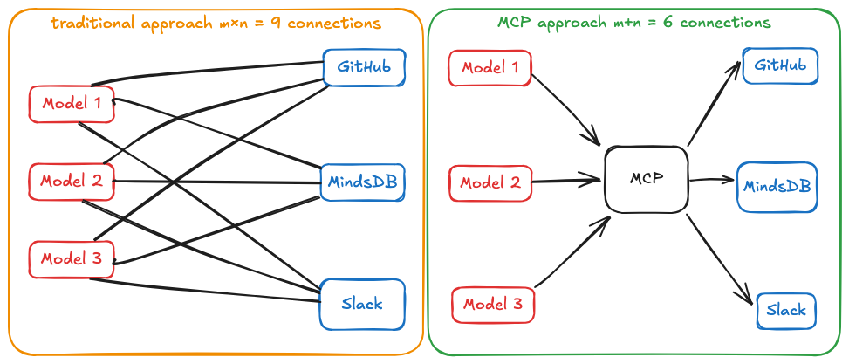
MxN Integration Problem
Source

Slide 60
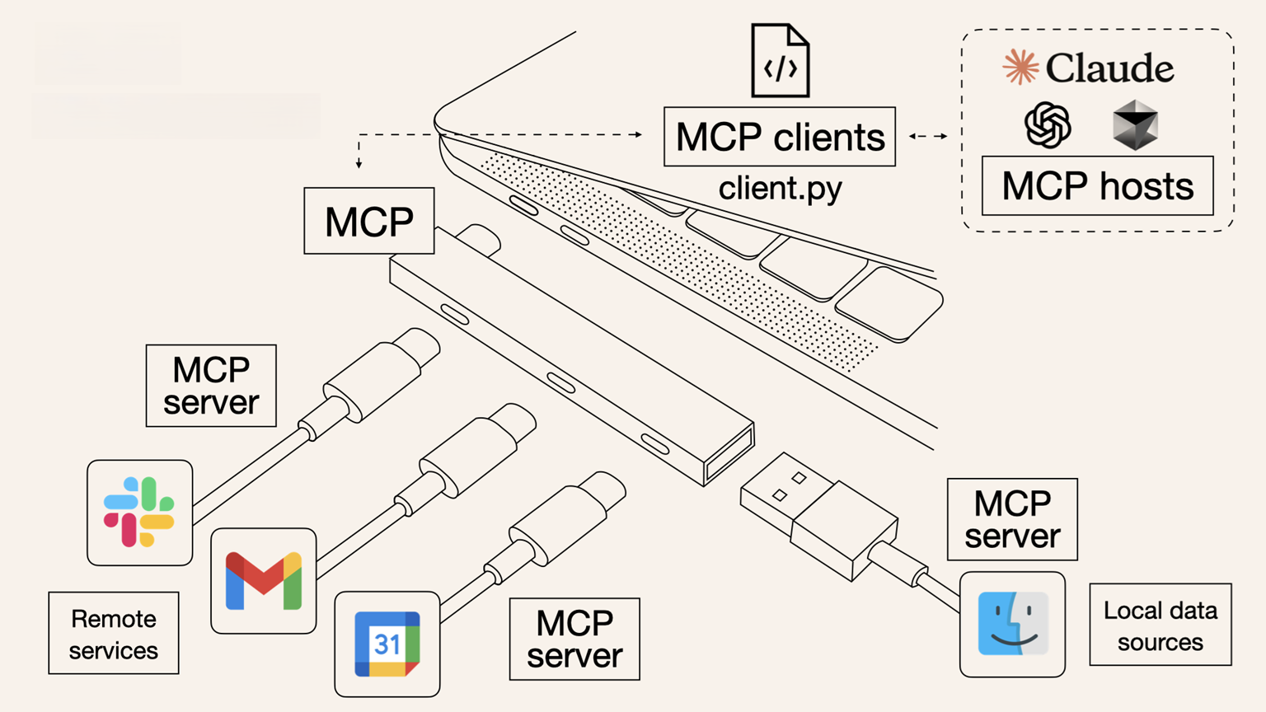
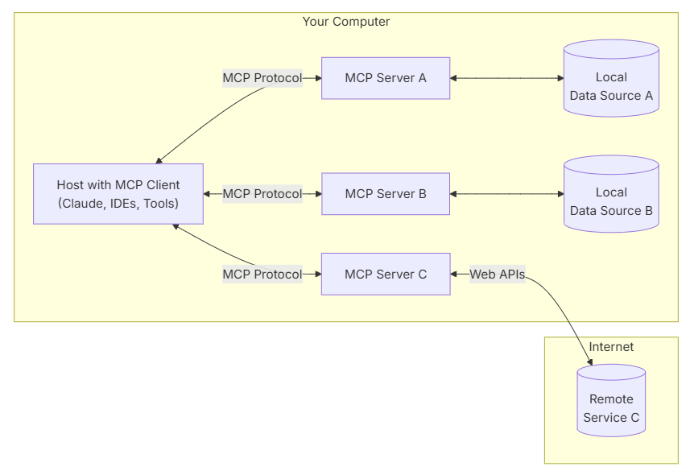
Model Context Protocol (MCP)
MCP is an open protocol that standardizes how applications provide context to LLMs.
Single protocol: MCP acts as a standardized "connector," so integrating one MCP means potential access to multiple tools and services, not just one
Dynamic discovery: MCP allows AI models to dynamically discover and interact with available tools without hard-coded knowledge of each integration
Two-way communication: MCP supports persistent, real-time two-way communication. The AI model can both retrieve information and trigger actions dynamically

Slide 61
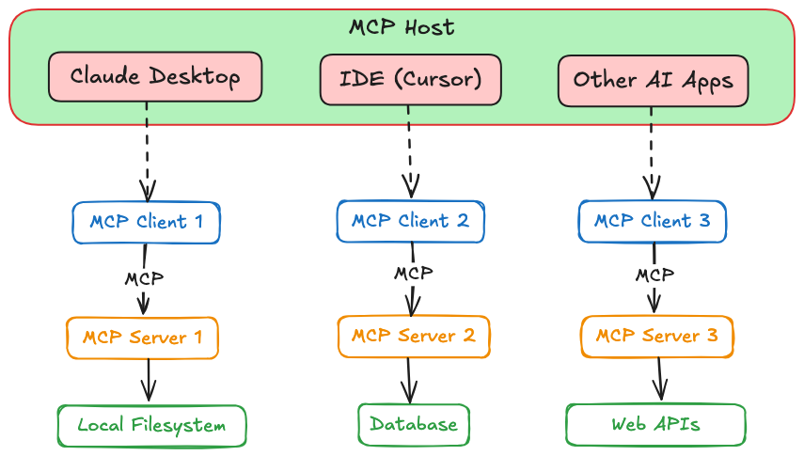
Architecture
MCP (Model Context Protocol) uses a client-server architecture to connect AI models with external resources, built on three key components: the Host, Clients, and Servers.
The Host is the AI application or agent the user interacts with (e.g., a desktop app, IDE plugin, or custom LLM app). It can simultaneously connect to multiple MCP Servers.
An MCP Client acts as an intermediary, managing each server connection. Each client handles communication with a single MCP Server, providing security isolation. The Host spawns one client per server, creating a dedicated, one-to-one link.
The MCP Server is an external program implementing the MCP standard. It offers specific capabilities, including tools, data access, and domain-related prompts. Servers can interface with databases, cloud services, and other data sources, with existing examples for Google Drive, Slack, GitHub, various databases, and web browsers.
Source Image

Slide 62
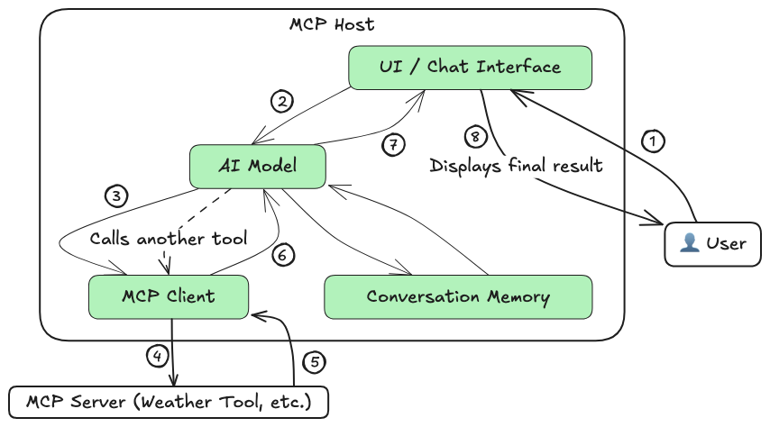
How it Works
Capability Discovery: The MCP client fetches the list of available tools/resources from the server and shares it with the AI model.
Augmented Prompting: The user's query is sent to the model along with descriptions of the server's tools/resources, enabling the model to understand what external actions are possible.
Tool/Resource Selection: The model decides if an external tool is needed and responds with a structured request (per MCP spec) indicating the desired tool (e.g., “Weather API”).
Server Execution: The client invokes the requested tool on the MCP server, which performs the action (e.g., API call or database query) and returns the result.
Response Generation: The model receives the result, integrates it with its own knowledge, and generates a final, enriched response for the user.
Source Image

Slide 63
MCP vs. RAG and Vector Search
RAG appends retrieved documents directly into prompts as raw text — useful but unstructured.
MCP offers structured context management: retrieved data is slotted into labeled Resource blocks (e.g., “Retrieved Documents”), keeping different types of information organized.
You can combine RAG with MCP: fetch via vector search, then pass results as structured context — easier to manage, update, and debug.

Slide 64
MCP vs. Monolithic Prompts and Finetuning
Traditional methods relied on:
Monolithic prompts – bulky, hard to edit, expensive (token-wise).
Fine-tuning – slow, costly, hard to adapt on the fly.
MCP enables modular prompting:
Define reusable context layers (e.g., “Policy Guidelines”, “User History”).
Update individual layers without rewriting or retraining.
Saves time and tokens while improving flexibility and maintainability.

Slide 65
MCP vs. Function Calling and Plugins
Function calling/tools in LLMs (like OpenAI plugins) are powerful but fragmented — each provider has its own setup.
MCP standardizes tool use across models with unified Tool, Prompt, and Resource primitives.
Interoperable & extensible:
Write once, work across providers (e.g., OpenAI, Claude, Llama).
Covers non-functional context needs (like guidance, templates) beyond API calls.

Slide 66
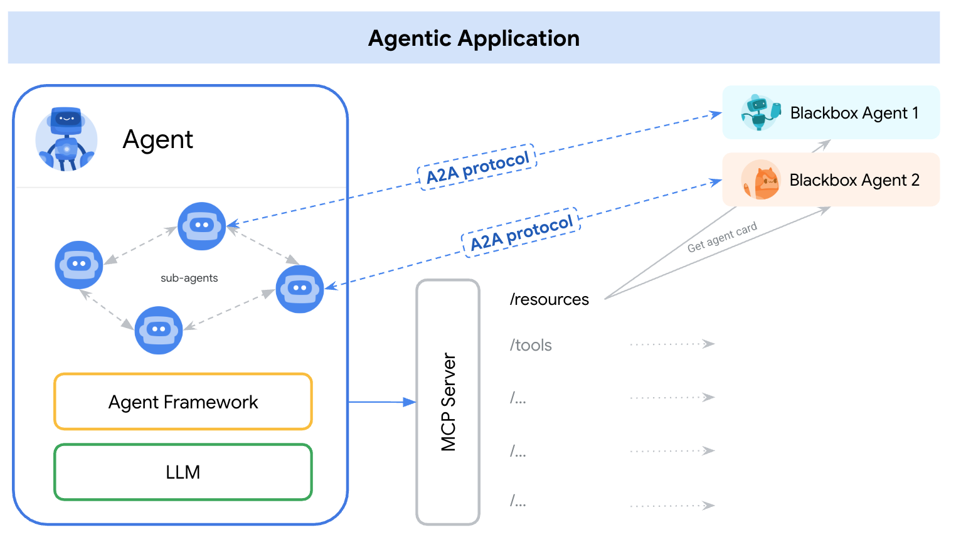
MCP vs. A2A
A2A and MCP are both complementary protocols
Feature | Agent2Agent Protocol (A2A) | Model Context Protocol (MCP)
Interaction | Between agents (from different frameworks also!) | Between agent and tools
Use Case | Delegating tasks to other agents | Enhancing context with external data
Dependency | Relies on other agents | Relies on tool integrations
Architecture | Multi-agent system | Tool-augmented single-agent system
MCP and A2A Integration
By representing A2A agents as MCP resources—encapsulated within their AgentCards—AI applications facilitate dynamic agent discovery.
This allows agents on an MCP server to connect and collaborate via the A2A protocol.
Inage source here

Slide 67
Basics of FastMCP and CrewAI
Notes:
Create an alternate journey slide that has the process for a platform team buyer persona
Get Numbers for the usage thing to Nikunj
In the pipeline things mention that the
Elevance – platform
Otsuka –business
Pfizer – Business Team
Medidata – both business and platform
Team slide, put team wise and some logo – only few people
Add G2 Review slide
Add Public Recognition
Elevance guy quote – Elevance thing This foundry is unlike any other foundry
Other Google review and all
Unique insights
GTM Slides pick from email
Long Term Direction Slide
Auto Pilot (Product Screenshots)
Competitors thing add
Product Deep dive explaining the product -> Modules -> One important slide and 3-4 follow up slides kinda thing
Fundraise slide – How much etc.
Ingest customer stories from throughout

Slide 68
Important Links for FastMCP
https://gofastmcp.com/tutorials/mcp
https://gofastmcp.com/tutorials/create-mcp-server
https://gofastmcp.com/getting-started/quickstart

Slide 69
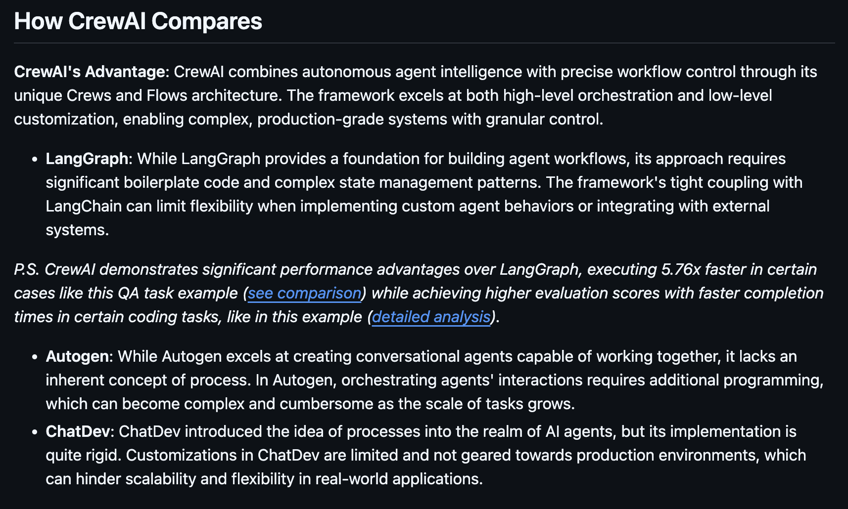
What CrewAI Says
https://github.com/crewAIInc/crewAI?tab=readme-ov-file#how-crewai-compares

Slide 70
Deploy Your First MCP Server
Notes:
Create an alternate journey slide that has the process for a platform team buyer persona
Get Numbers for the usage thing to Nikunj
In the pipeline things mention that the
Elevance – platform
Otsuka –business
Pfizer – Business Team
Medidata – both business and platform
Team slide, put team wise and some logo – only few people
Add G2 Review slide
Add Public Recognition
Elevance guy quote – Elevance thing This foundry is unlike any other foundry
Other Google review and all
Unique insights
GTM Slides pick from email
Long Term Direction Slide
Auto Pilot (Product Screenshots)
Competitors thing add
Product Deep dive explaining the product -> Modules -> One important slide and 3-4 follow up slides kinda thing
Fundraise slide – How much etc.
Ingest customer stories from throughout

Slide 71
CI/CD
Notes:
Create an alternate journey slide that has the process for a platform team buyer persona
Get Numbers for the usage thing to Nikunj
In the pipeline things mention that the
Elevance – platform
Otsuka –business
Pfizer – Business Team
Medidata – both business and platform
Team slide, put team wise and some logo – only few people
Add G2 Review slide
Add Public Recognition
Elevance guy quote – Elevance thing This foundry is unlike any other foundry
Other Google review and all
Unique insights
GTM Slides pick from email
Long Term Direction Slide
Auto Pilot (Product Screenshots)
Competitors thing add
Product Deep dive explaining the product -> Modules -> One important slide and 3-4 follow up slides kinda thing
Fundraise slide – How much etc.
Ingest customer stories from throughout

Slide 72
What Does It Mean for Agentic AI?

Slide 73
Evaluating LLM Applications
Notes:
Create an alternate journey slide that has the process for a platform team buyer persona
Get Numbers for the usage thing to Nikunj
In the pipeline things mention that the
Elevance – platform
Otsuka –business
Pfizer – Business Team
Medidata – both business and platform
Team slide, put team wise and some logo – only few people
Add G2 Review slide
Add Public Recognition
Elevance guy quote – Elevance thing This foundry is unlike any other foundry
Other Google review and all
Unique insights
GTM Slides pick from email
Long Term Direction Slide
Auto Pilot (Product Screenshots)
Competitors thing add
Product Deep dive explaining the product -> Modules -> One important slide and 3-4 follow up slides kinda thing
Fundraise slide – How much etc.
Ingest customer stories from throughout

Slide 74
Why Evaluate at All?
Evaluation helps address and identify the bottlenecks related to:
Hallucinations (absence of relevant context in final prompt is the most common reason for this, but there could be others)
Reduced reasoning capabilities (if all the relevant context is not provided to LLM, it can lead to this)
Unexpected latencies (what would happen is the retrieval might not be efficient leading to high latencies)
Explainability of outputs (i.e., was performance bad due to the LLM itself or due to other aspects of the application – think agents, RAG, agentic RAG etc.)
It also helps build trust among users especially for use in high-stakes industries like Finance, Healthcare etc.
And in general, it is a best practice for building any kind of an “AI” application.

Slide 75
Evaluating a RAG Application
Typically we think of evaluating only the outputs. And if the result is poor, we might attribute it to the LLM itself.
However, remember such an LLM application is based off RAG, and instead of only focusing on “G” = Generation, we need to also evaluate the “R” = Retrieval which is the other main pillar of such an application.
Output vs. Output Evaluation
Context vs. Context Evaluation
Generated Output
Judge
Correct Output
Retrieved Context
Judge
Correct Context
But even then, with the correct context, sometimes the LLM doesn’t ground the output in the context leading to hallucinations!
SOLUTION: There are a lot of evaluation metrics that help address these varied issues.

Slide 76
LLM-as-a-Judge Paradigm
As we discussed, there are more dimensions than just output vs. output evaluation.
But HOW do we do this?
Judge can be
Human (pros: super good; cons: time-expensive, not scalable)
a Statistical NLP based method (pros: deterministic, scalable; cons: limited in semantic capabilities)
an LLM itself! = LLM as a Judge! (pros: good semantic capabilities, scalable; cons: scale comes with cost, black box/hallucination could potentially occur)
Multiple Dimensions
Who is the Judge?
Multiple Dimensions

Slide 77
Overview of Evaluation Metrics
Now let’s see an overview of evaluation metrics, and the dimensions each of these is designed to evaluate.
Dimensions
S.No. | Metric | User Question | Ground Truth Context | Retrieved Context | Actual Answer | Generated Answer
1 | Context Precision@k | ❌ | ✅ | ✅ | ❌(✅) | ❌
2 | Context Recall | ❌ | ✅ | ✅ | ❌(✅) | ❌
3 | Faithfulness | ❌ | ❌ | ✅ | ❌ | ✅
4 | Answer Relevancy | ✅ | ❌ | ❌ | ❌ | ✅
5 | Prompt Alignment | ✅ | ❌ | ❌ | ❌ | ✅
6 | Toxicity | ❌ | ❌ | ❌ | ❌ | ✅
Retrieval
Metrics
Generation Metrics
We’ll deep-dive into S.No. 1-6 using the popular frameworks RAGAs and DeepEval in Python.

Slide 78
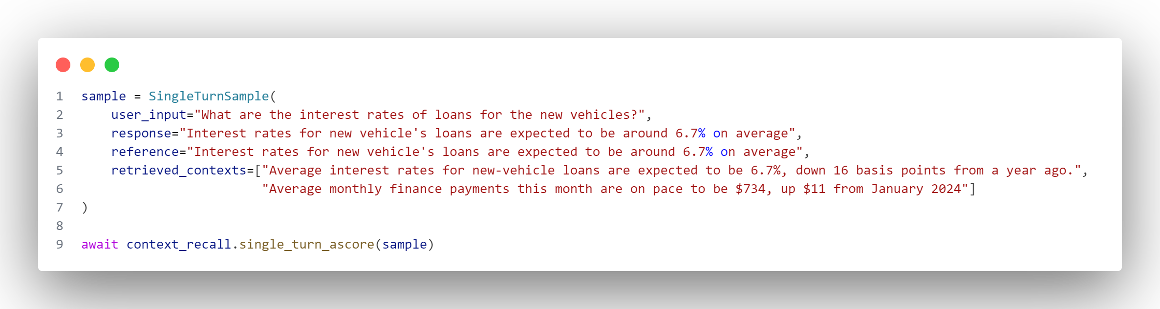
Evaluation Metric 1: Context Recall
Key Takeaway
Out of the relevant available context, how much relevant context is retrieved?
(can be done using actual answer also, instead of ground truth context)
User Question | Ground Truth Context | Retrieved Context | Actual Answer | Generated Answer
❌ | ✅ | ✅ | ❌(✅) | ❌
Definition
$$Context Recall=\frac{Number of claims in the reference supported by the context}{Total number of claims in the reference}$$
Code Snippet
(RAGAs)
Output
1.0
Relative Cost of Evaluation
Small to medium depending on system prompt length

Slide 79
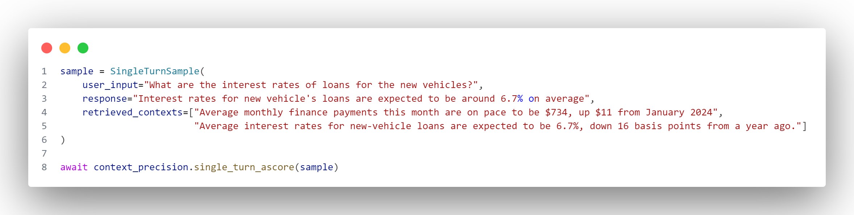
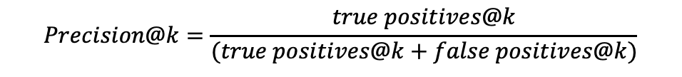
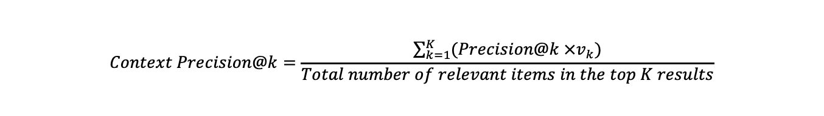
Evaluation Metric 2: Context Precision@k
Out of the all context that’s retrieved, how much context is relevant and ranked higher than irrelevant ones?
(can be done using actual answer also, instead of ground truth context)
User Question | Ground Truth Context | Retrieved Context | Actual Answer | Generated Answer
❌ | ✅ | ✅ | ❌(✅) | ❌
Key Takeaway
$$Precision@k=\frac{true positives@k}{(true positives@k+false positives@k)}$$
Definition
$$Context Precision@k=\frac{\sum_{k=1}^{K}{(Precision@k ×v_{k})}}{Total number of relevant items in the top K results}$$
Code Snippet
(RAGAs)
Output
0.5
Relative Cost of Evaluation
Small to medium depending on system prompt length

Slide 80
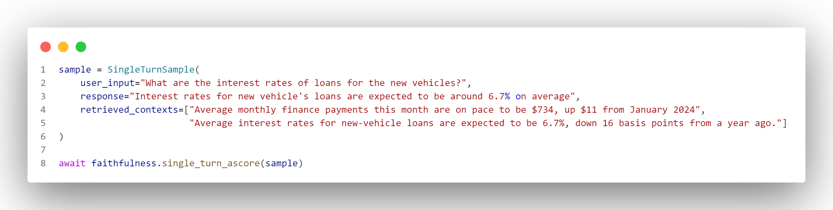
Evaluation Metric 3: Faithfulness
Key Takeaway
How much of the generated answer is attributed to the retrieved context, versus, the model’s own knowledge base?
User Question | Ground Truth Context | Retrieved Context | Actual Answer | Generated Answer
❌ | ❌ | ✅ | ❌ | ✅
Definition
$$Faithfulness Score=\frac{Number of claims in the response supported by the retrieved context}{Total number of claims in the response}$$
Code Snippet
(RAGAs)
Output
1.0
Relative Cost of Evaluation
Small to medium depending on system prompt length

Slide 81
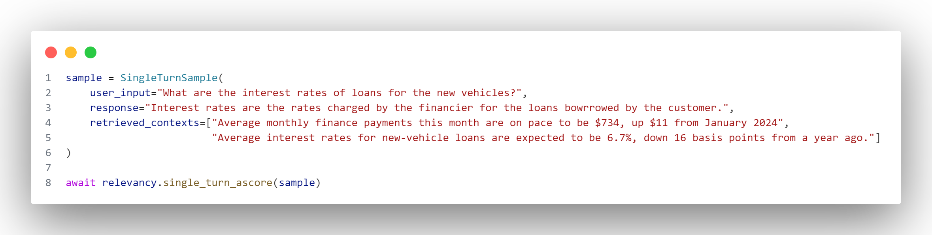
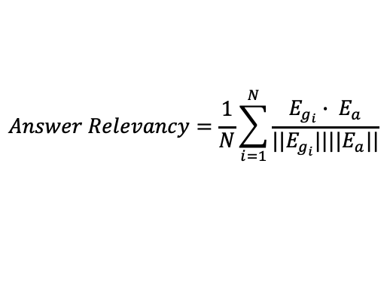
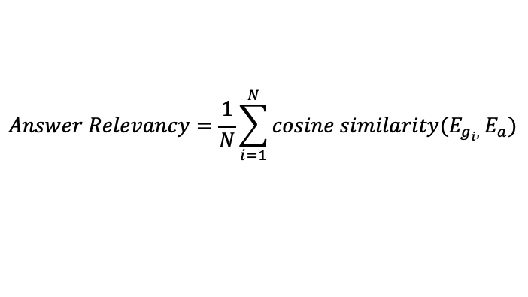
Evaluation Metric 4: Answer Relevancy
Key Takeaway
How relevant is the response generated by the LLM, compared to what the user had originally asked?
User Question | Ground Truth Context | Retrieved Context | Actual Answer | Generated Answer
✅ | ❌ | ❌ | ❌ | ✅
Definition
$$Answer Relevancy=\frac{1}{N}\sum_{i=1}^{N}{cosine similarity(E_{g_{i}, }E_{a})}$$
$$Answer Relevancy=\frac{1}{N}\sum_{i=1}^{N}{\frac{E_{g_{i}}∙ E_{a}}{||E_{g_{i}}||||E_{a}||}}$$
$$by default, 3 questions (i.e., N=3) are generated by the LLM but this parameter can be changed$$
Code Snippet
(RAGAs)
Output
0.56
Relative Cost of Evaluation
Medium to large as multiple LLM calls are involved

Slide 82
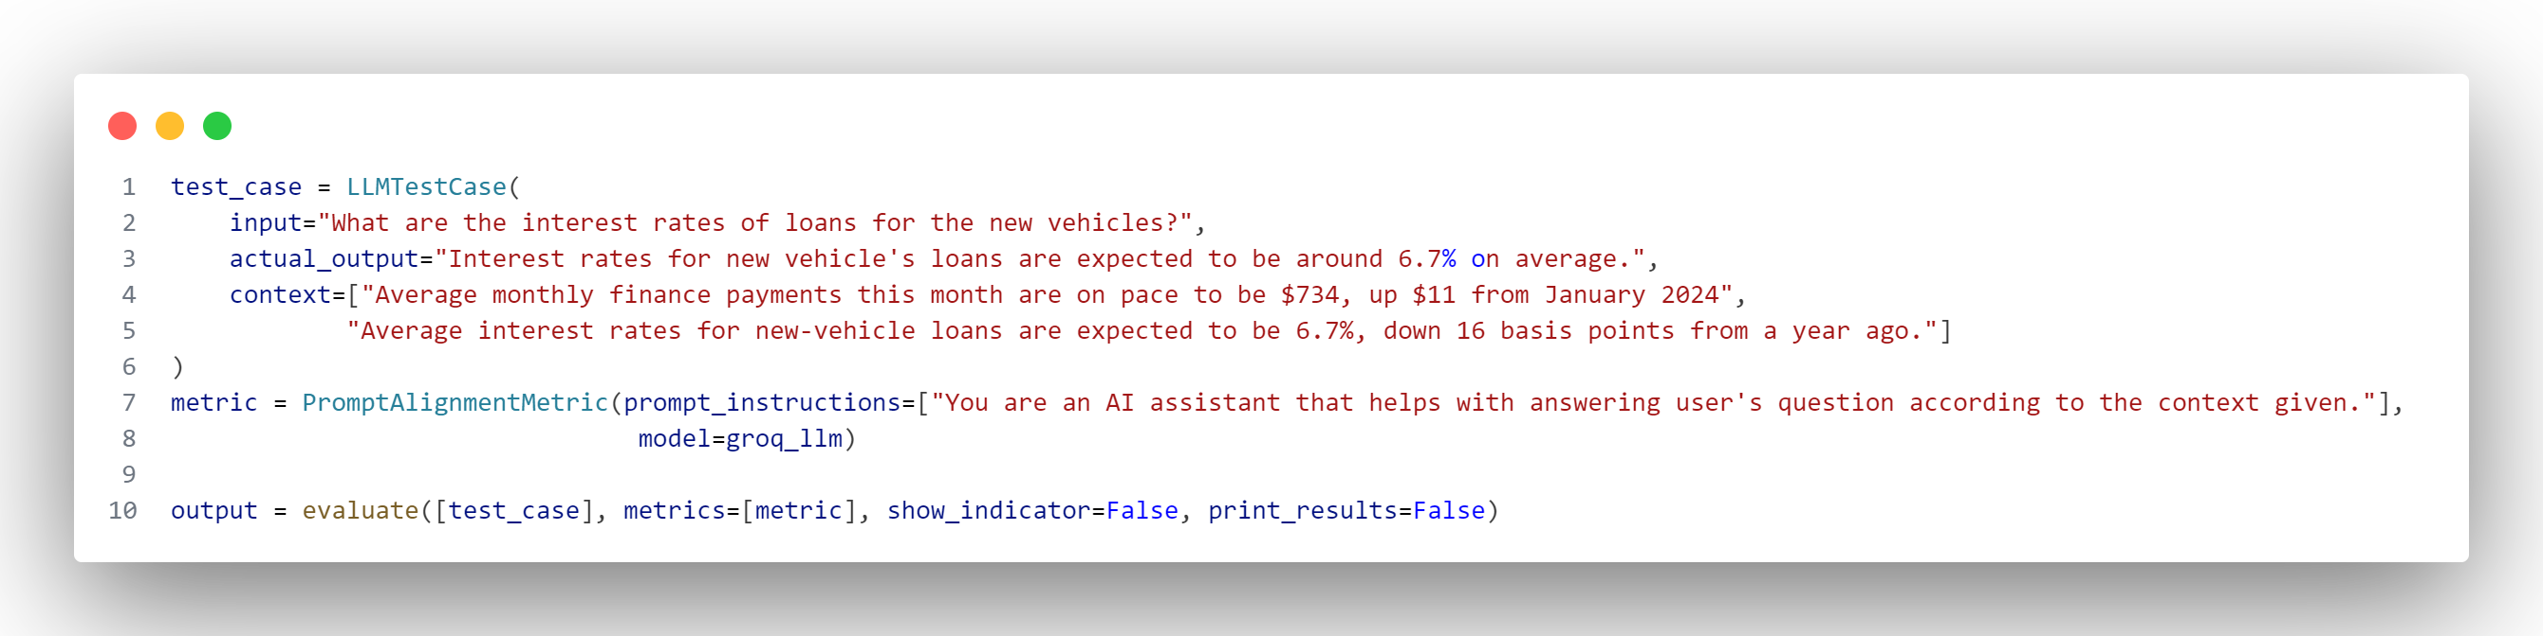
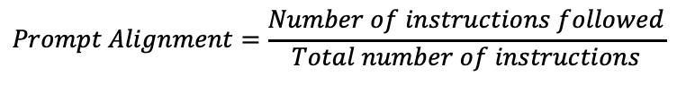
Evaluation Metric 5: Prompt Alignment
Key Takeaway
How well did the generated answer follow the instructions mentioned in the prompt?
User Question | Ground Truth Context | Retrieved Context | Actual Answer | Generated Answer
✅ | ❌ | ❌ | ❌ | ✅
Definition
$$Prompt Alignment=\frac{Number of instructions followed}{Total number of instructions}$$
Code Snippet
(DeepEval)
Output
1.0
Relative Cost of Evaluation
Medium to large as multiple LLM calls are involved
By default it’s 2 (1. Checks the no. of instructions which were followed in the generated answer
2. Generates a reason for the score calculated given the verdict for the opinions for the
instructions which were not followed)

Slide 83
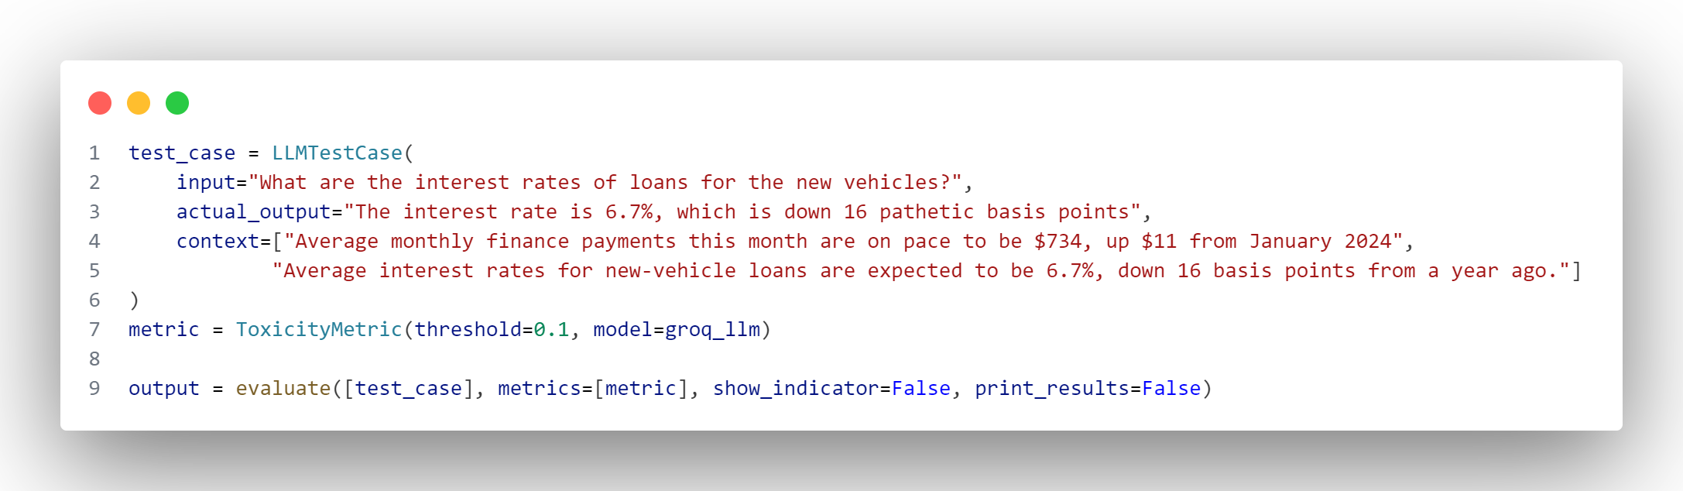
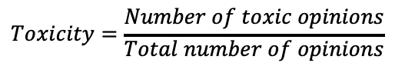
Evaluation Metric 6: Toxicity
Key Takeaway
Measures how toxic the generated response is, in terms of number of opinions.
User Question | Ground Truth Context | Retrieved Context | Actual Answer | Generated Answer
❌ | ❌ | ❌ | ❌ | ✅
Definition
$$Toxicity=\frac{Number of toxic opinions}{Total number of opinions}$$
Code Snippet
(DeepEval)
Output
1.0
Relative Cost of Evaluation
Medium to large as multiple LLM calls are involved
By default it’s 3 (1. Call to generate all the opinions in the generated answer
2. Checks which opinions are toxic
3. Generates a reason for the score calculated given the toxic opinions)

